Slide 1





Web Scraping & Web Services

Slide 2

Hello!
I am Eslam Ahmed
I am a software engineer.
You can find me at jeksogsa@gmail.com

Slide 3

Hello!
I am Eman Ehab
I am a ML research engineer.
You can find me at emanehab.ieee@gmail.com

Slide 4




What is Data Science
Data science is a concept to unify statistics, data
analysis, machine learning, domain knowledge and
their related methods" in order to "understand and
analyze actual phenomena with data.
It uses techniques and theories drawn from many fields
within the context of mathematics, statistics, computer
science, domain knowledge and information science.

Slide 5
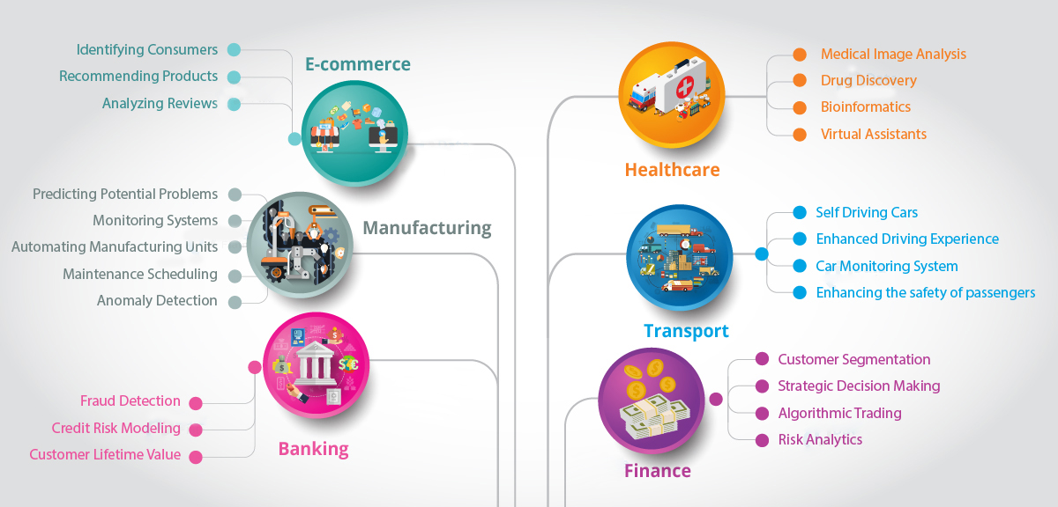
Applications of Data Science

Slide 6
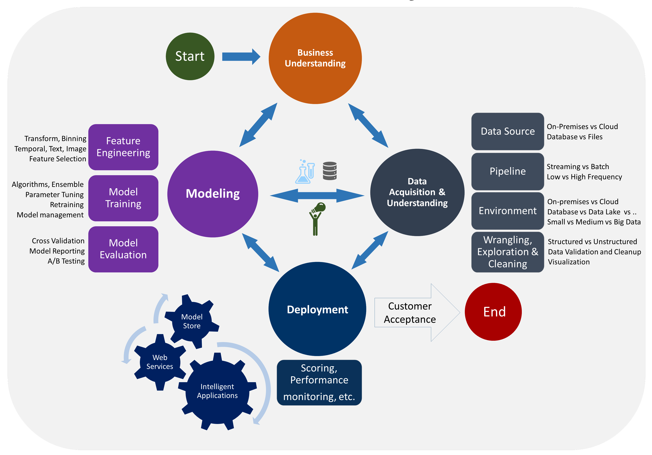
Data Science life cycle

Slide 7
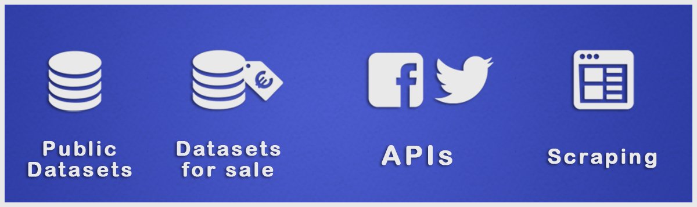
Data Collecting

Slide 8
Public Datasets
https://www.kaggle.com/datasets
http://archive.ics.uci.edu/ml/index.php
https://data.fivethirtyeight.com
https://github.com/BuzzFeedNews
https://opendata.socrata.com
https://cloud.google.com/bigquery/public-data
https://github.com/awesomedata/awesome-public-datasets
https://www.data.gov
http://academictorrents.com/browse.php
https://www.quandl.com/search
https://tinyletter.com/data-is-plural

Slide 9

Data Collecting
So What we do if there is
no datasets available ?!
We will learn about Web Scraping and Rest APIs web services

Slide 10
Agenda
What is Network Topologies
What is Internet and Web Servers
HTTP Request/Response Cycle
HTML
CSS
Scrapping Concept
BeautifulSoap Library
REST API Web Services
Work with JSON

Slide 11
Agenda
What is Network Topologies
What is Internet and Web Servers
HTTP Request/Response Cycle
HTML
CSS
Scrapping Concept
BeautifulSoap Library
REST API Web Services
Work with JSON

Slide 12
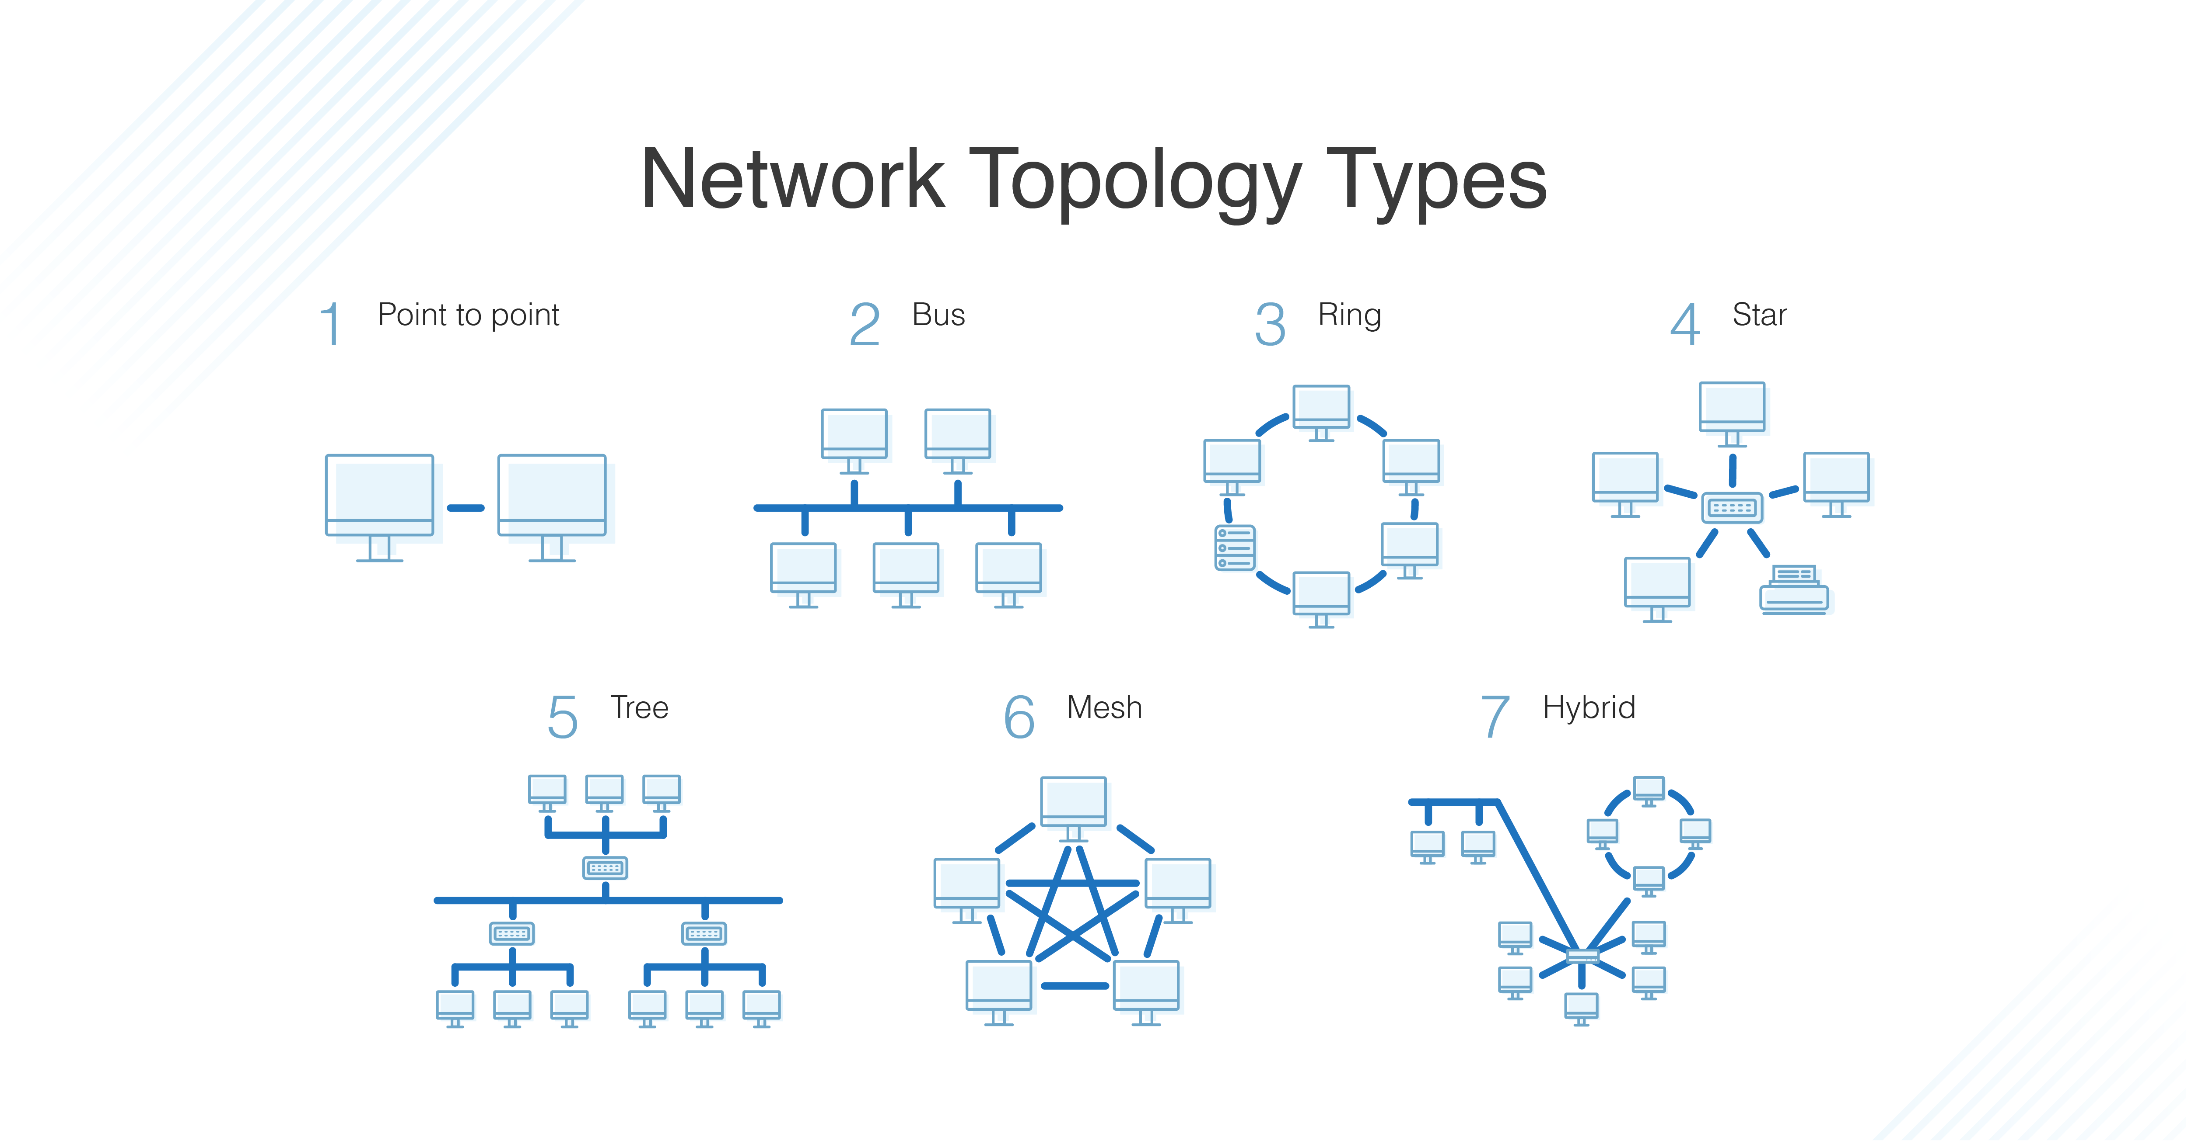
What is Network Topologies

Slide 13
Agenda
What is Network Topologies
What is Internet and Web Servers
HTTP Request/Response Cycle
HTML
CSS
Scrapping Concept
BeautifulSoap Library
REST API Web Services
Work with JSON

Slide 14
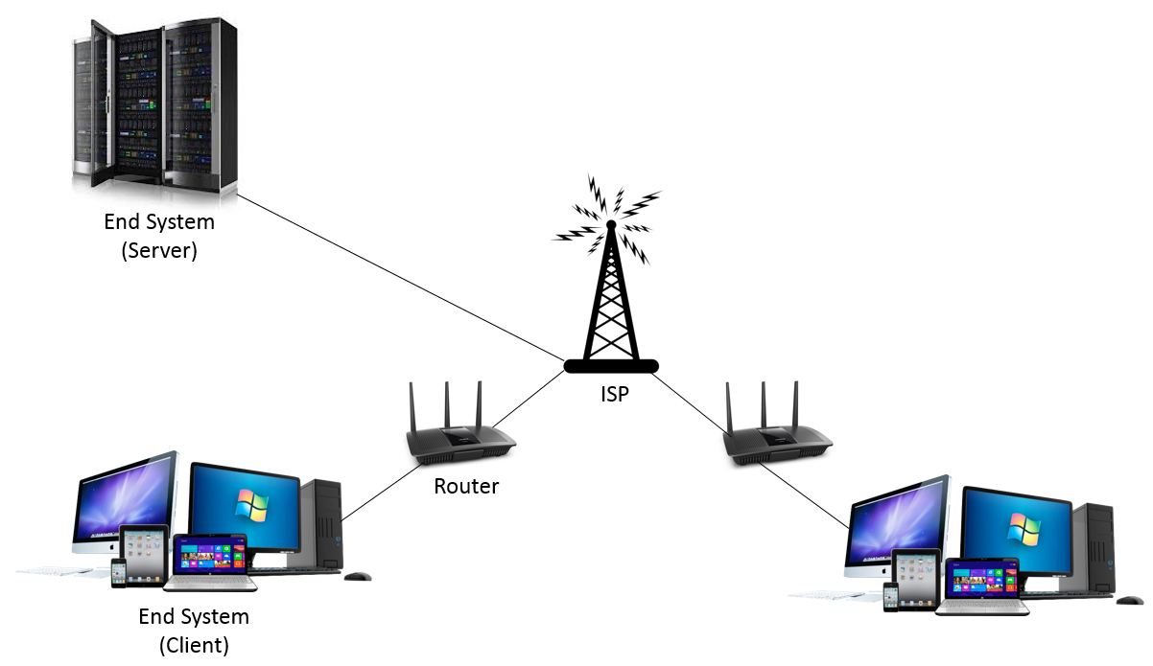
What is Internet and Web Servers

Slide 15
Agenda
What is Network Topologies
What is Internet and Web Servers
HTTP Request/Response Cycle
HTML
CSS
Scrapping Concept
BeautifulSoap Library
REST API Web Services
Work with JSON

Slide 16
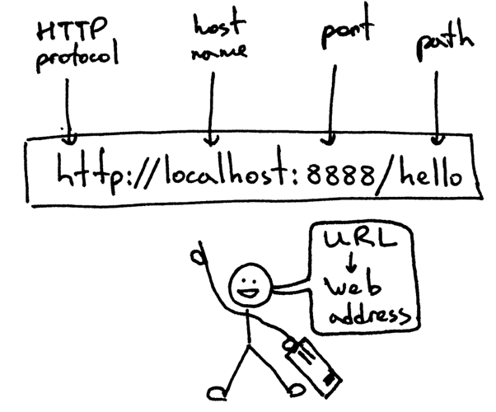
HTTP Request/Response Cycle

Slide 17
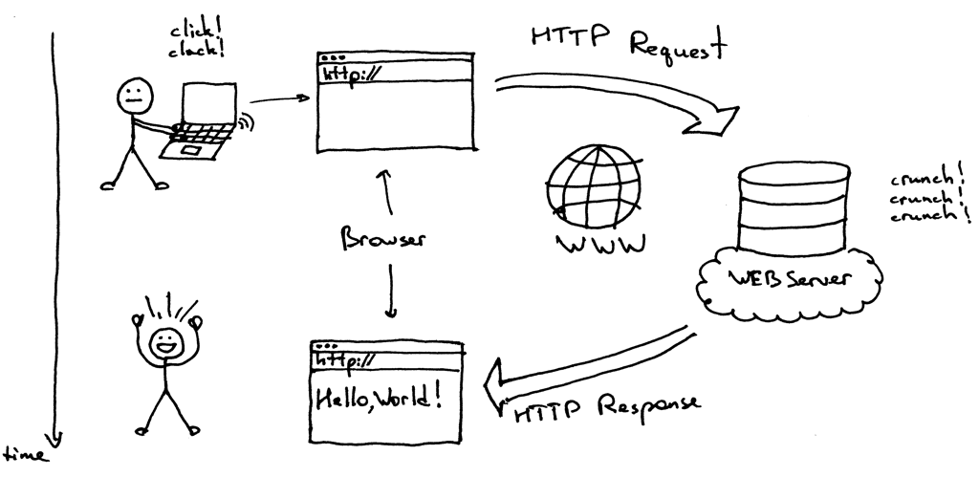
HTTP Request/Response Cycle

Slide 18
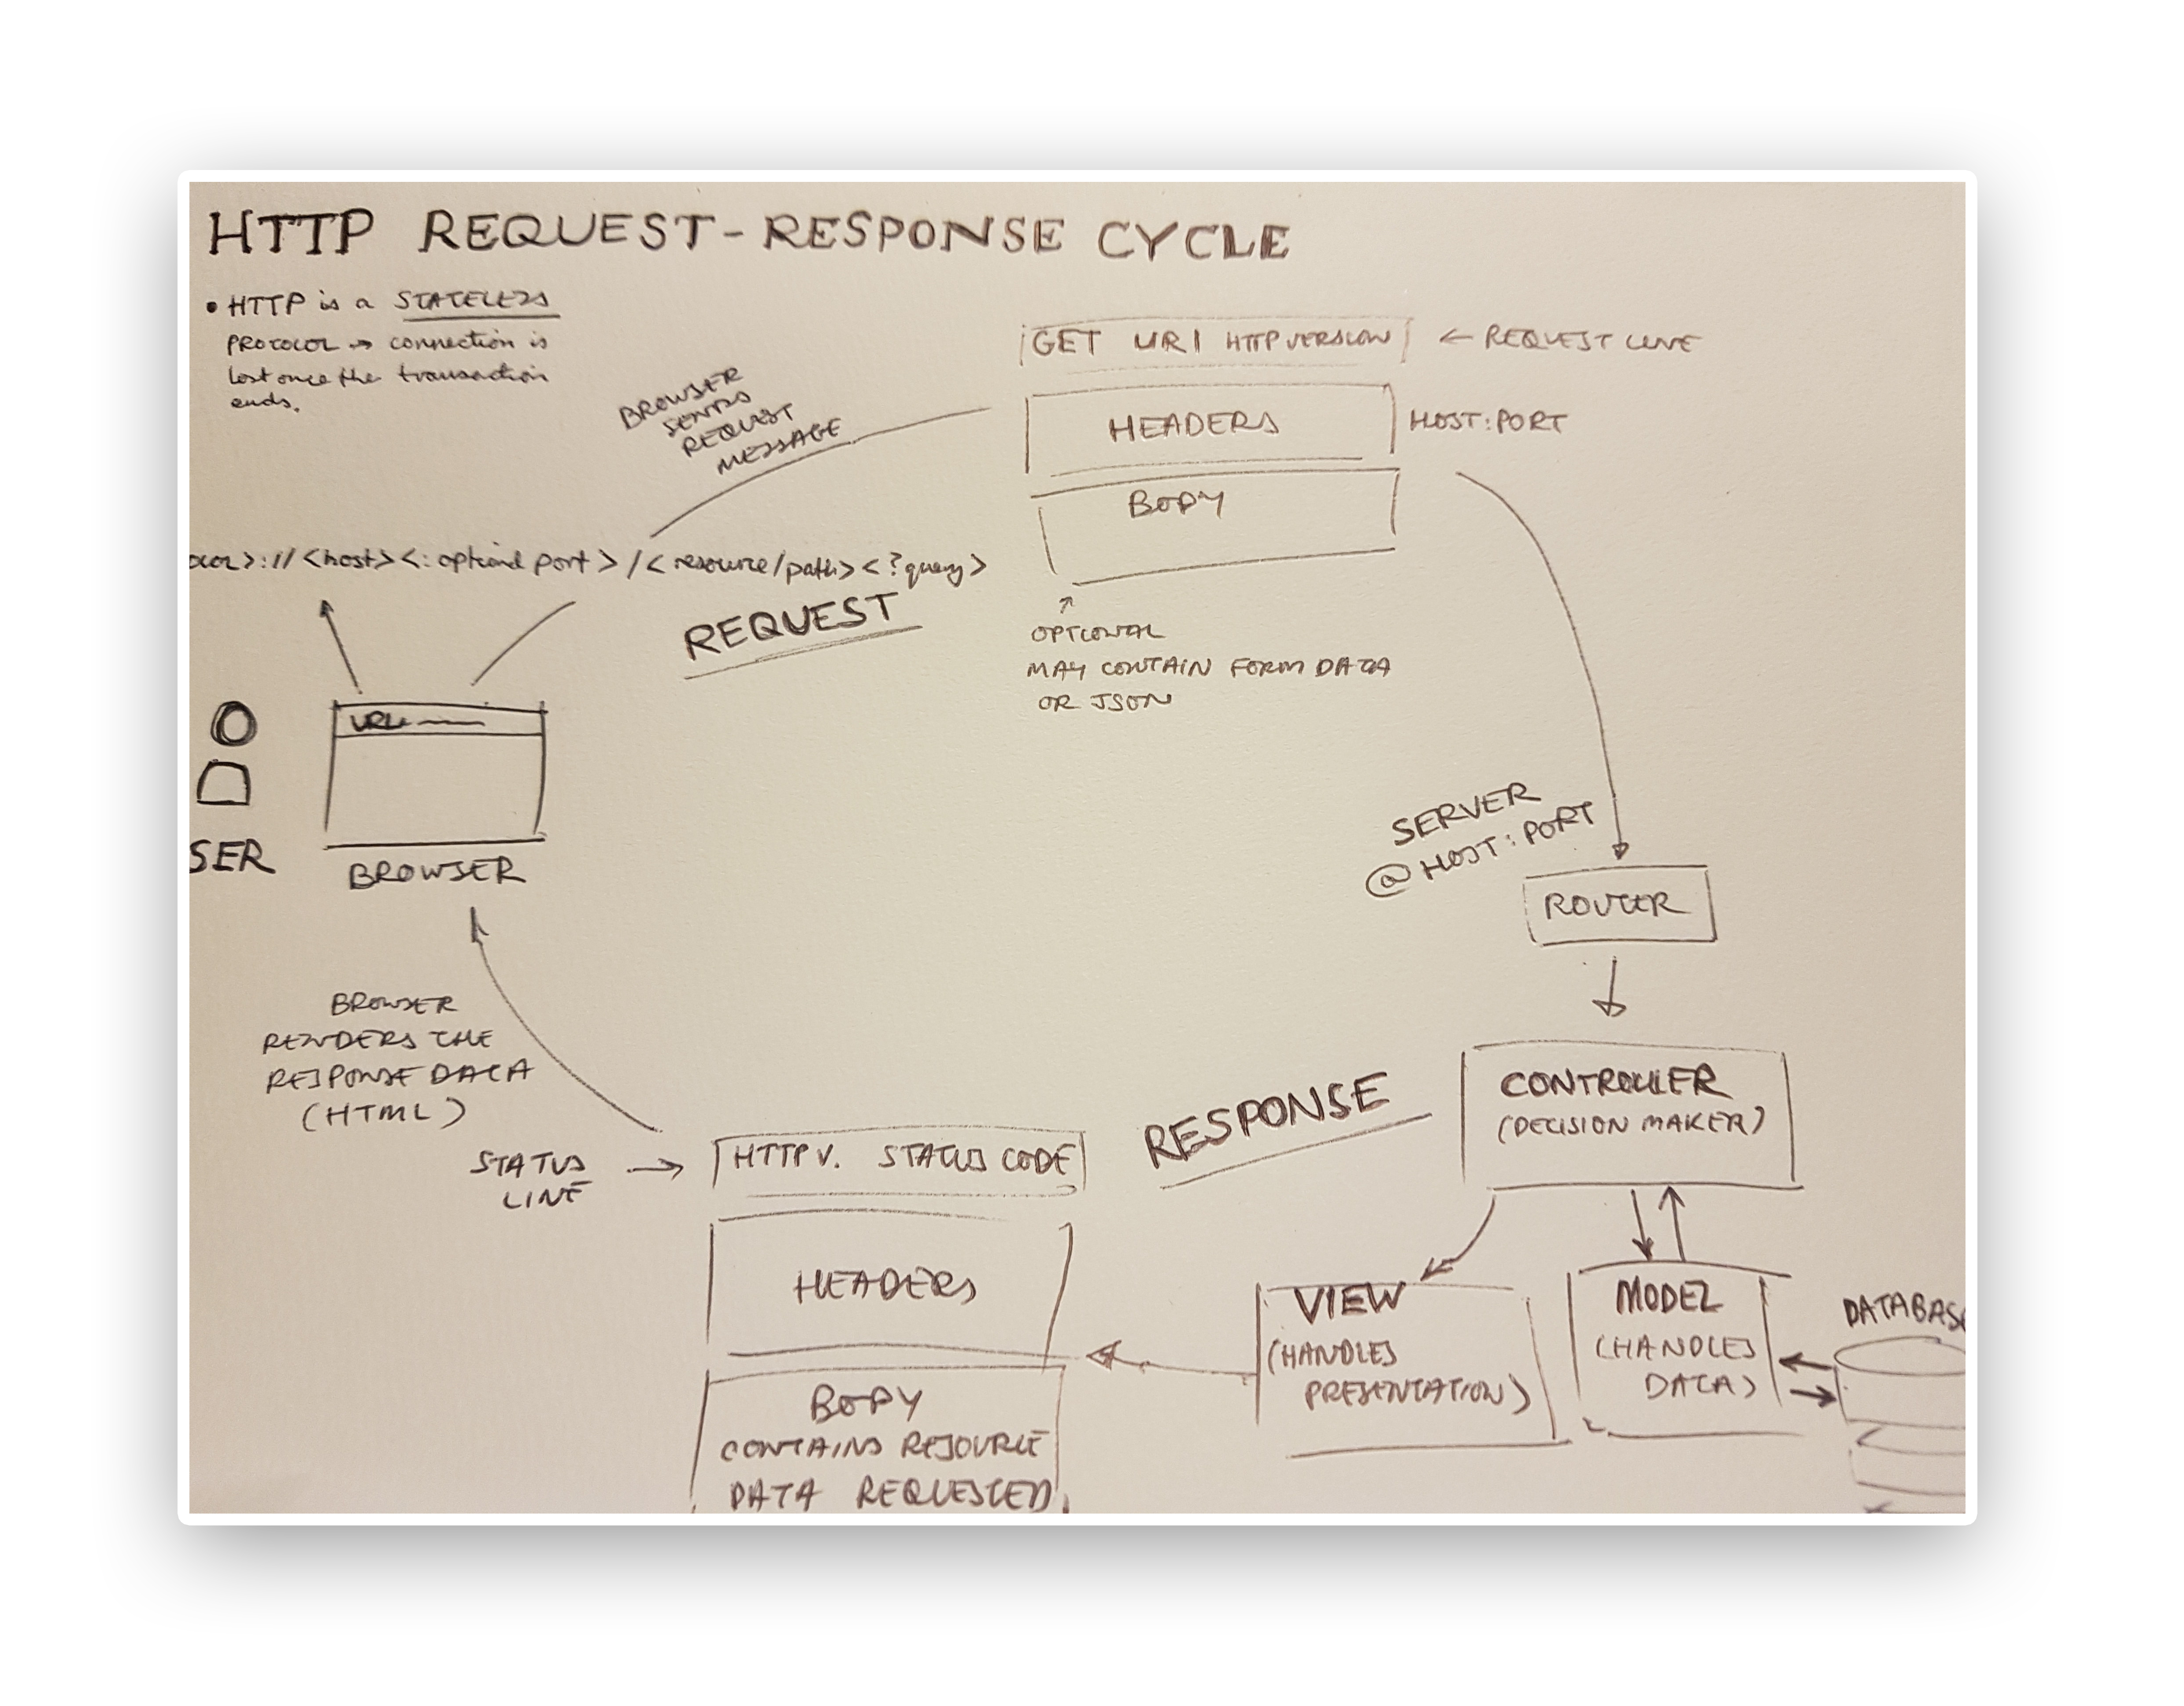

Slide 19
Agenda
What is Network Topologies
What is Internet and Web Servers
HTTP Request/Response Cycle
HTML
CSS
Scrapping Concept
BeautifulSoap Library
REST API Web Services
Work with JSON

Slide 20
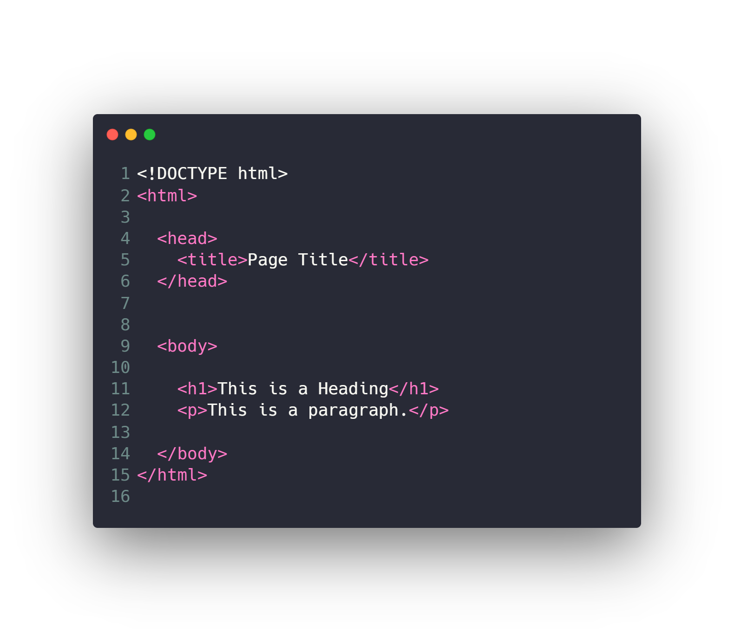
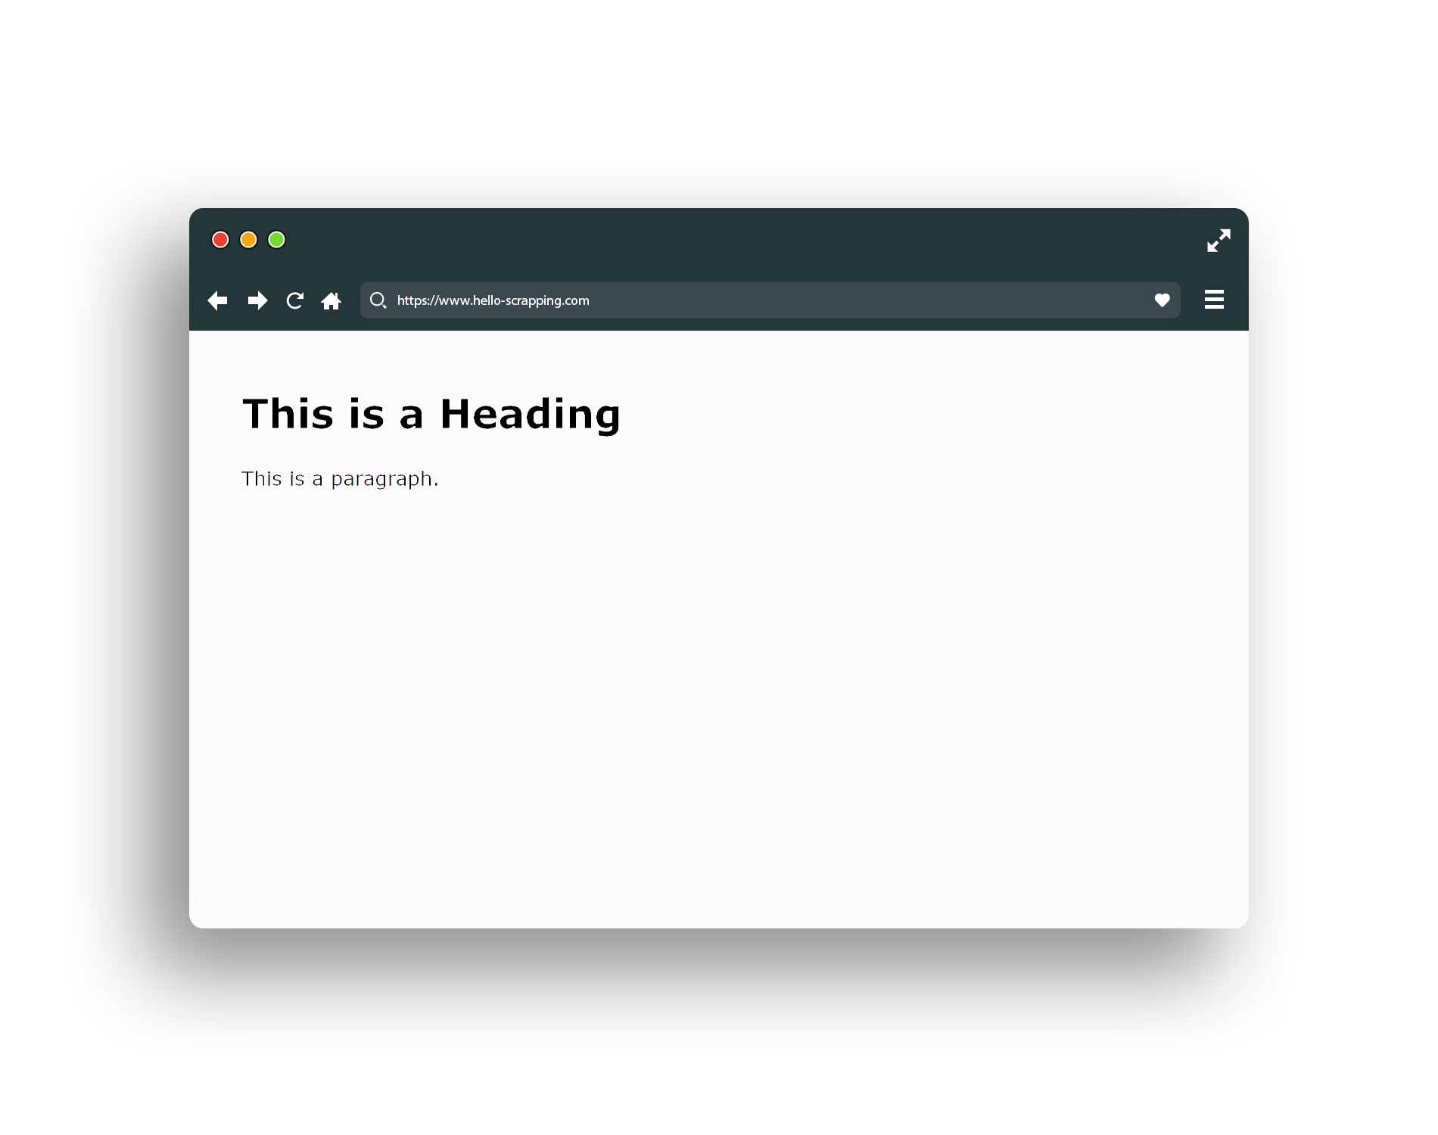
HTML (base snippet code)

Slide 21
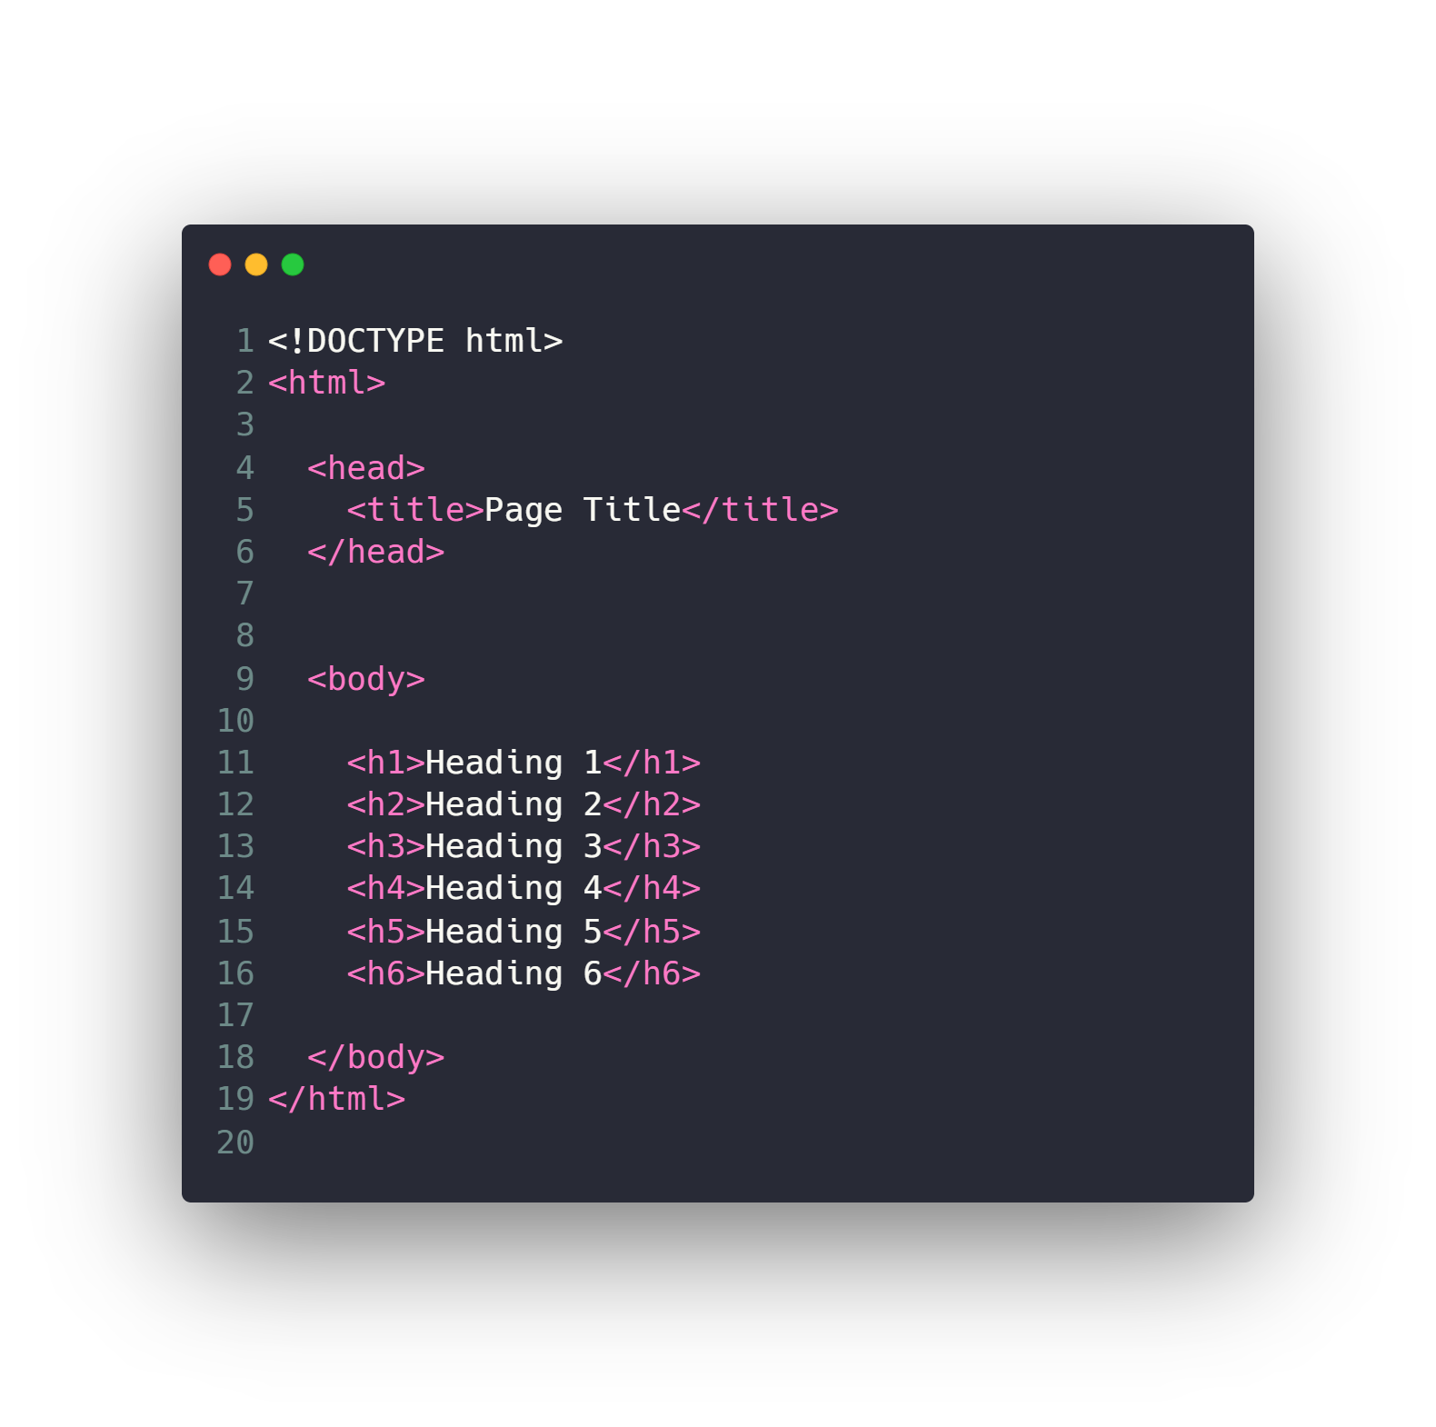
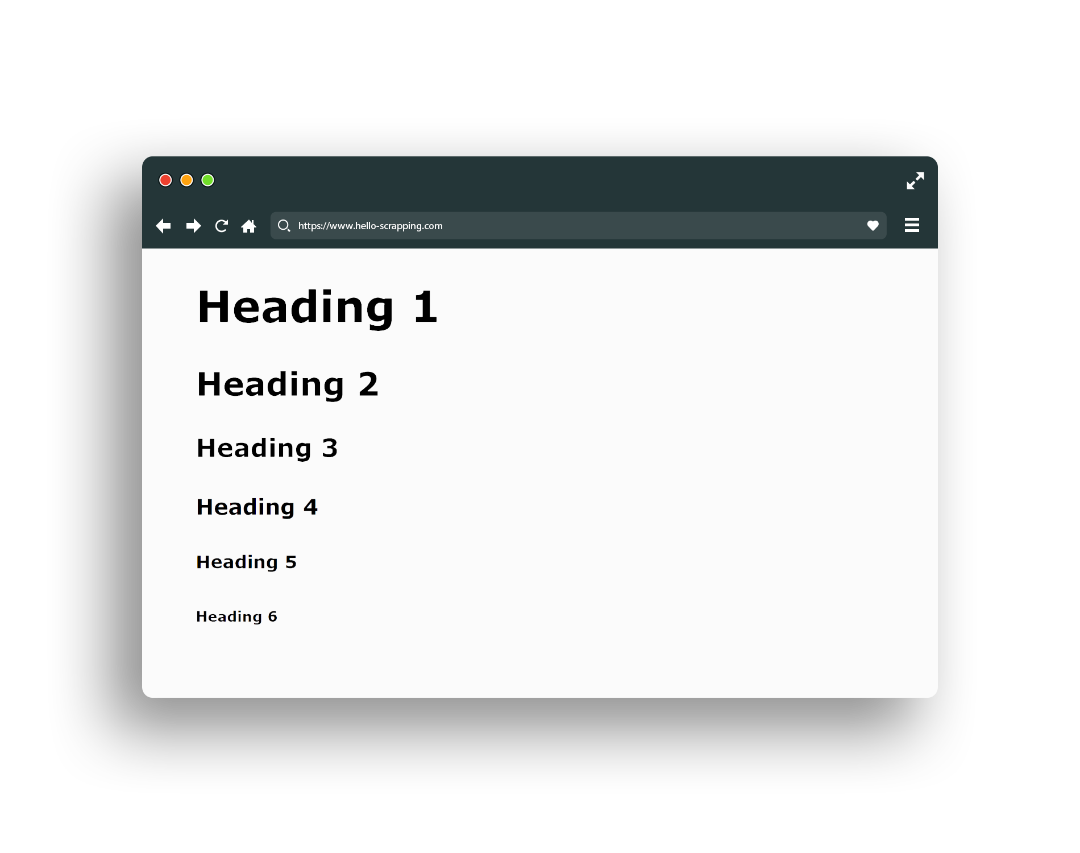
HTML (header)

Slide 22
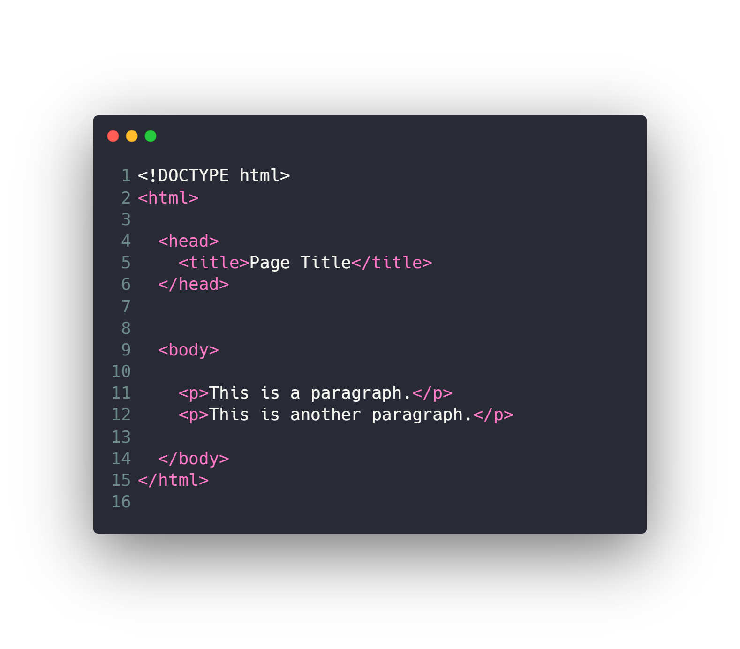
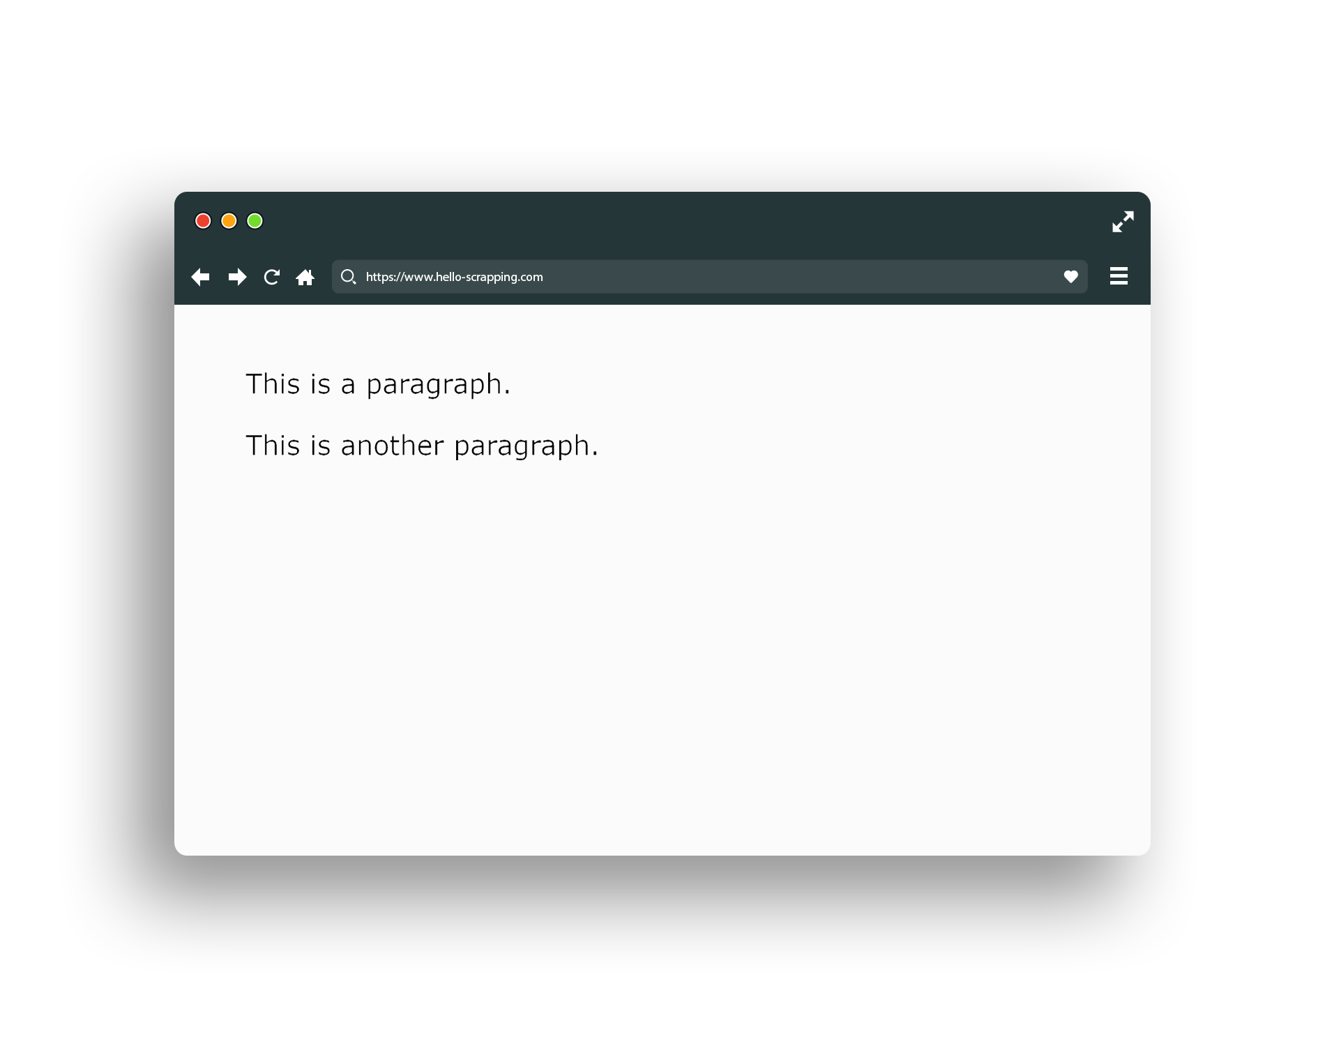
HTML (paragraph)

Slide 23
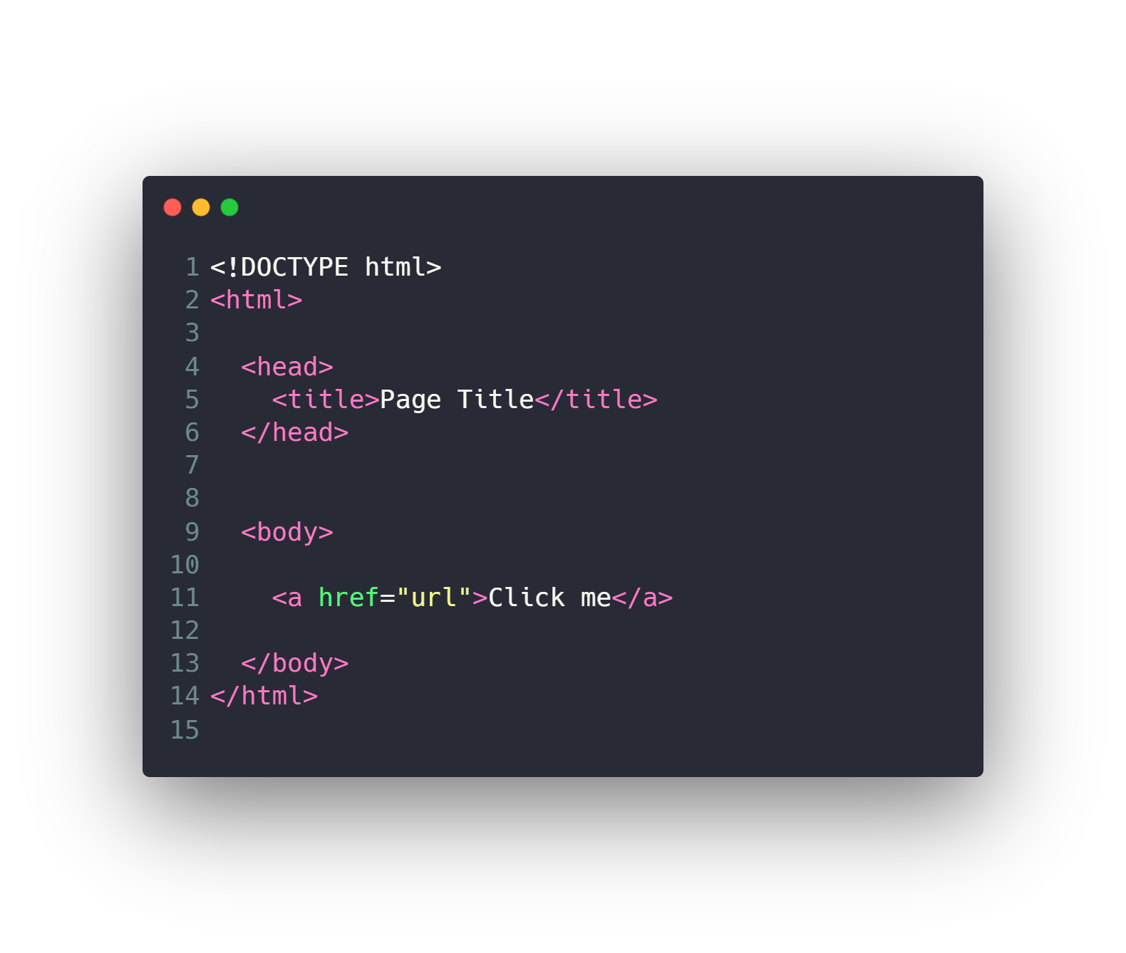
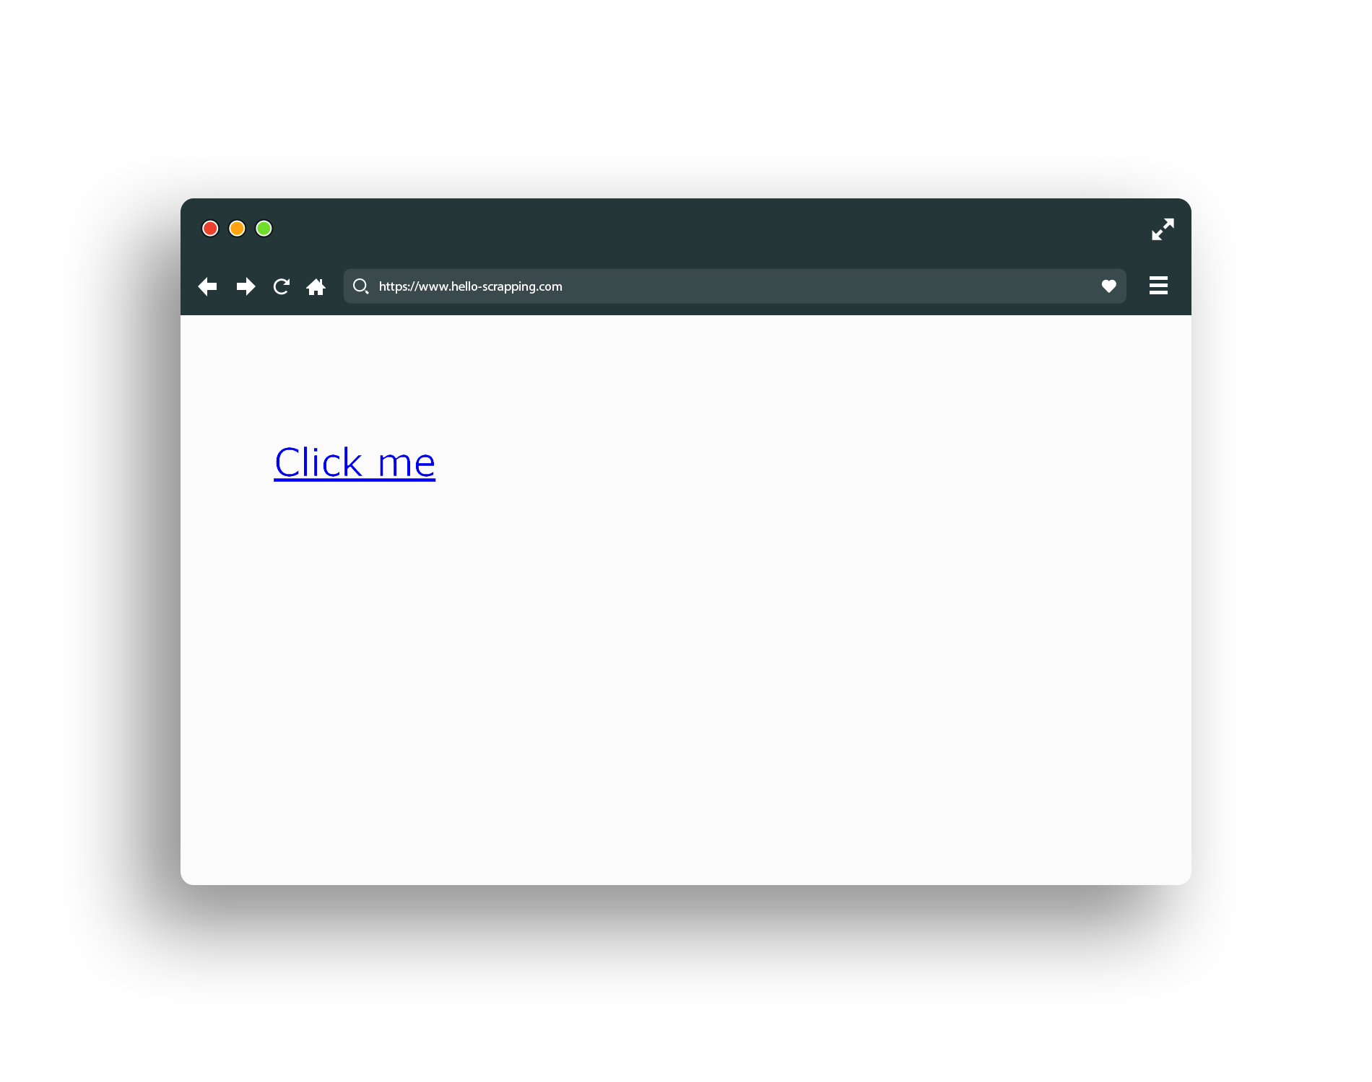
HTML (link)

Slide 24
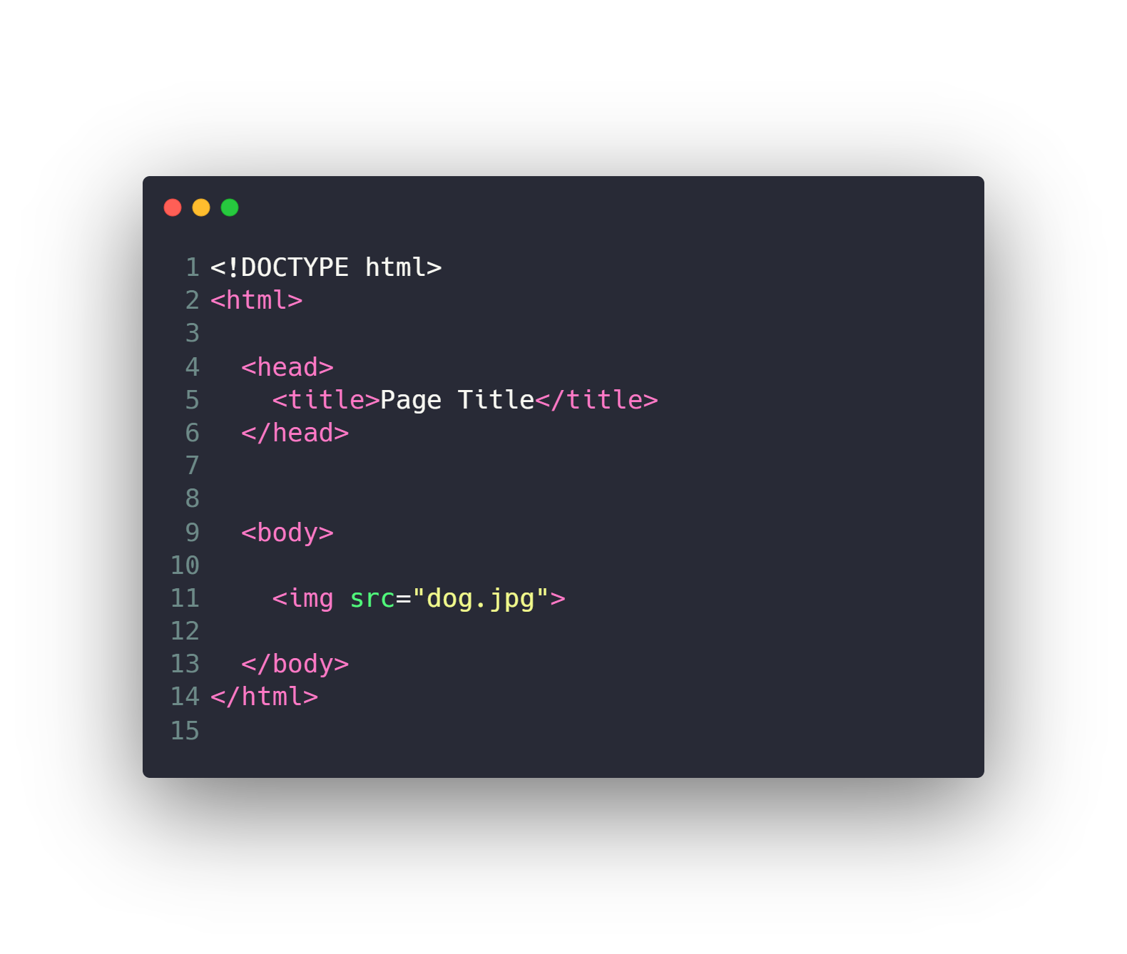
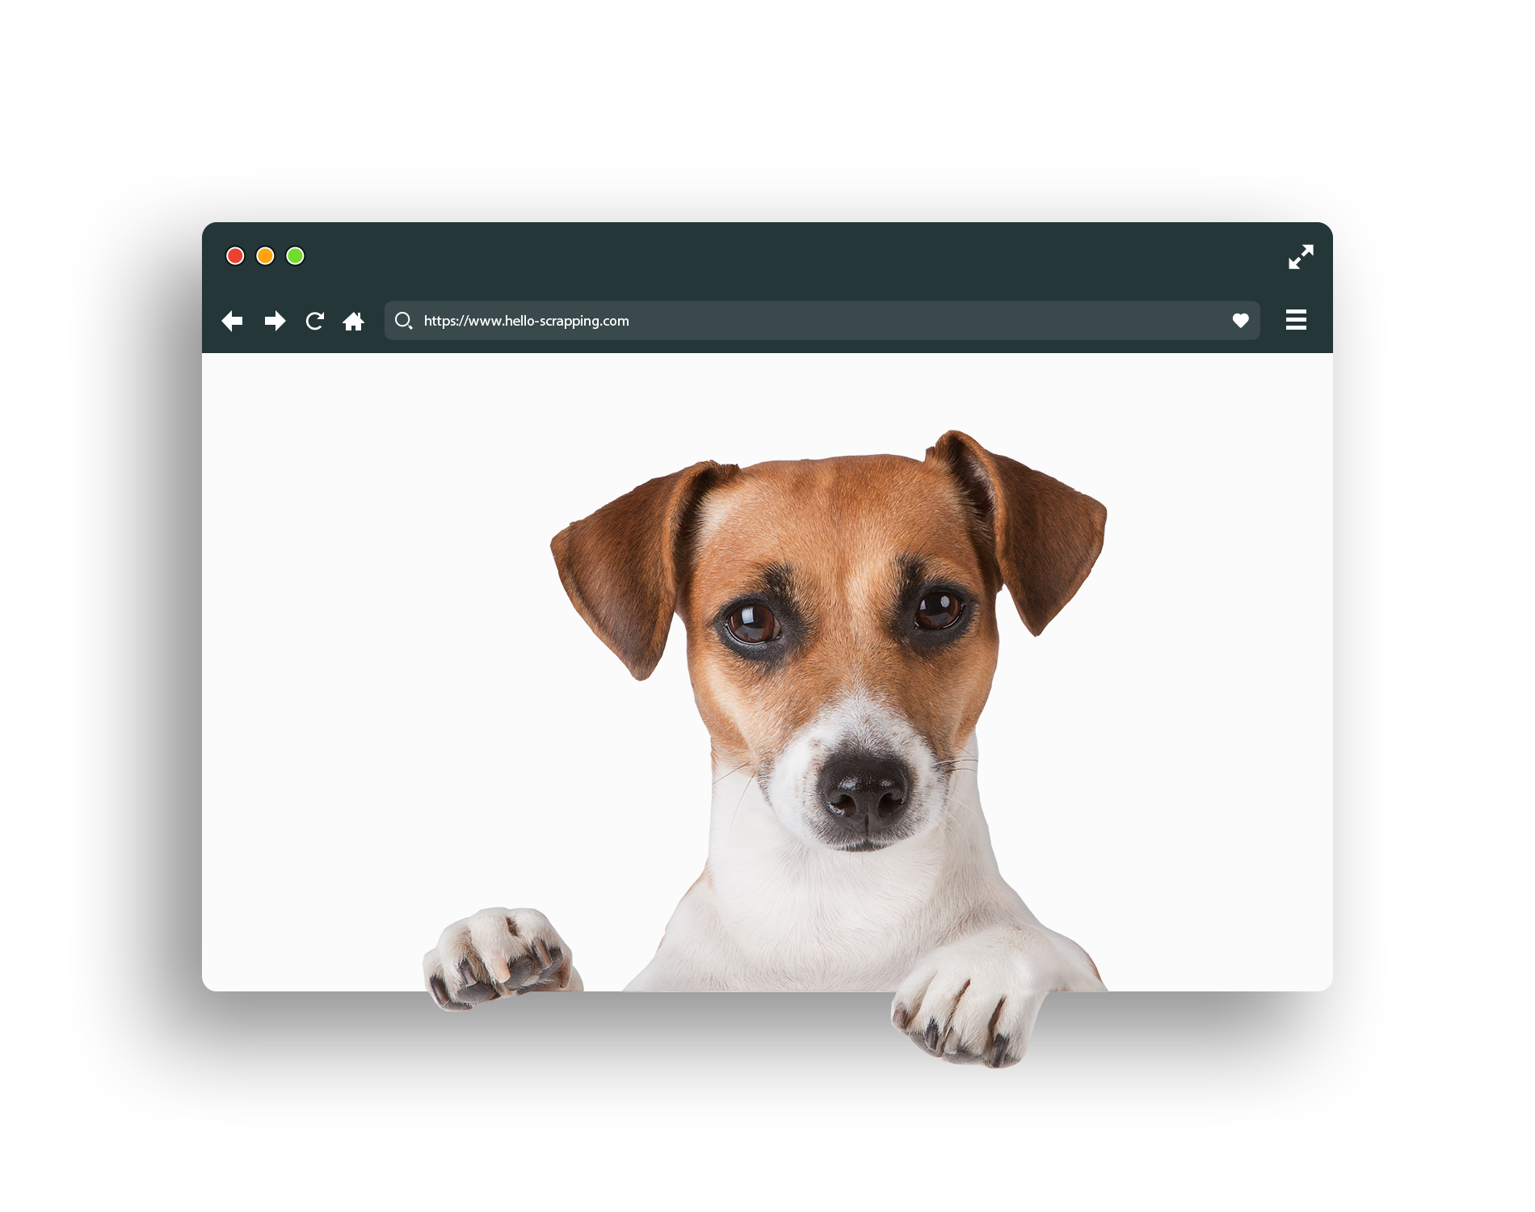
HTML (image)

Slide 25
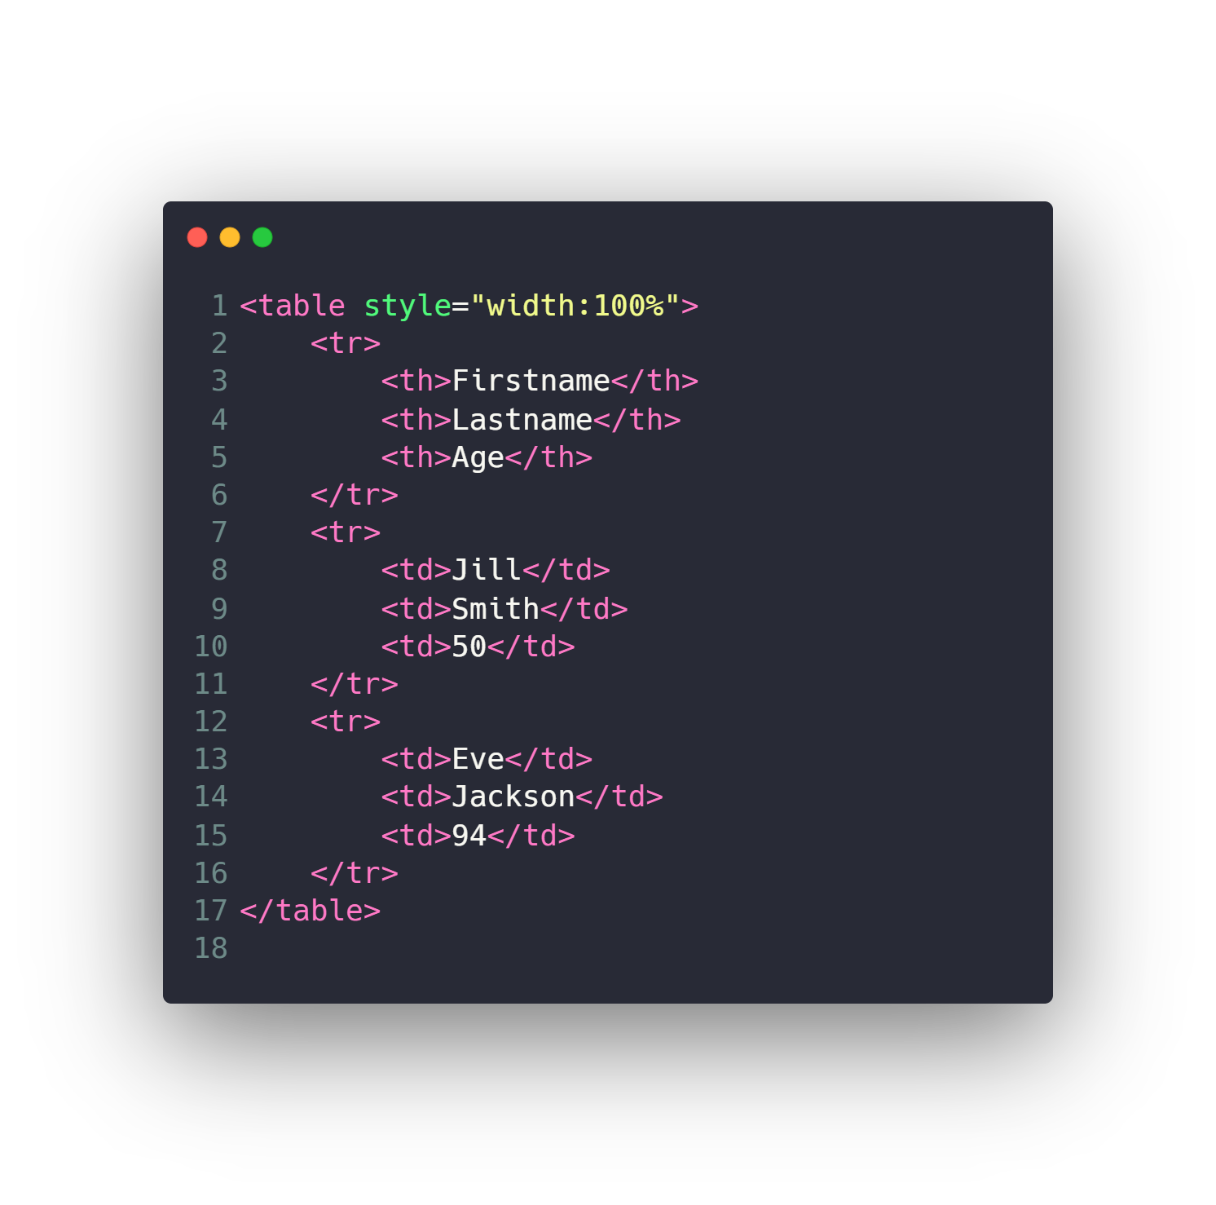
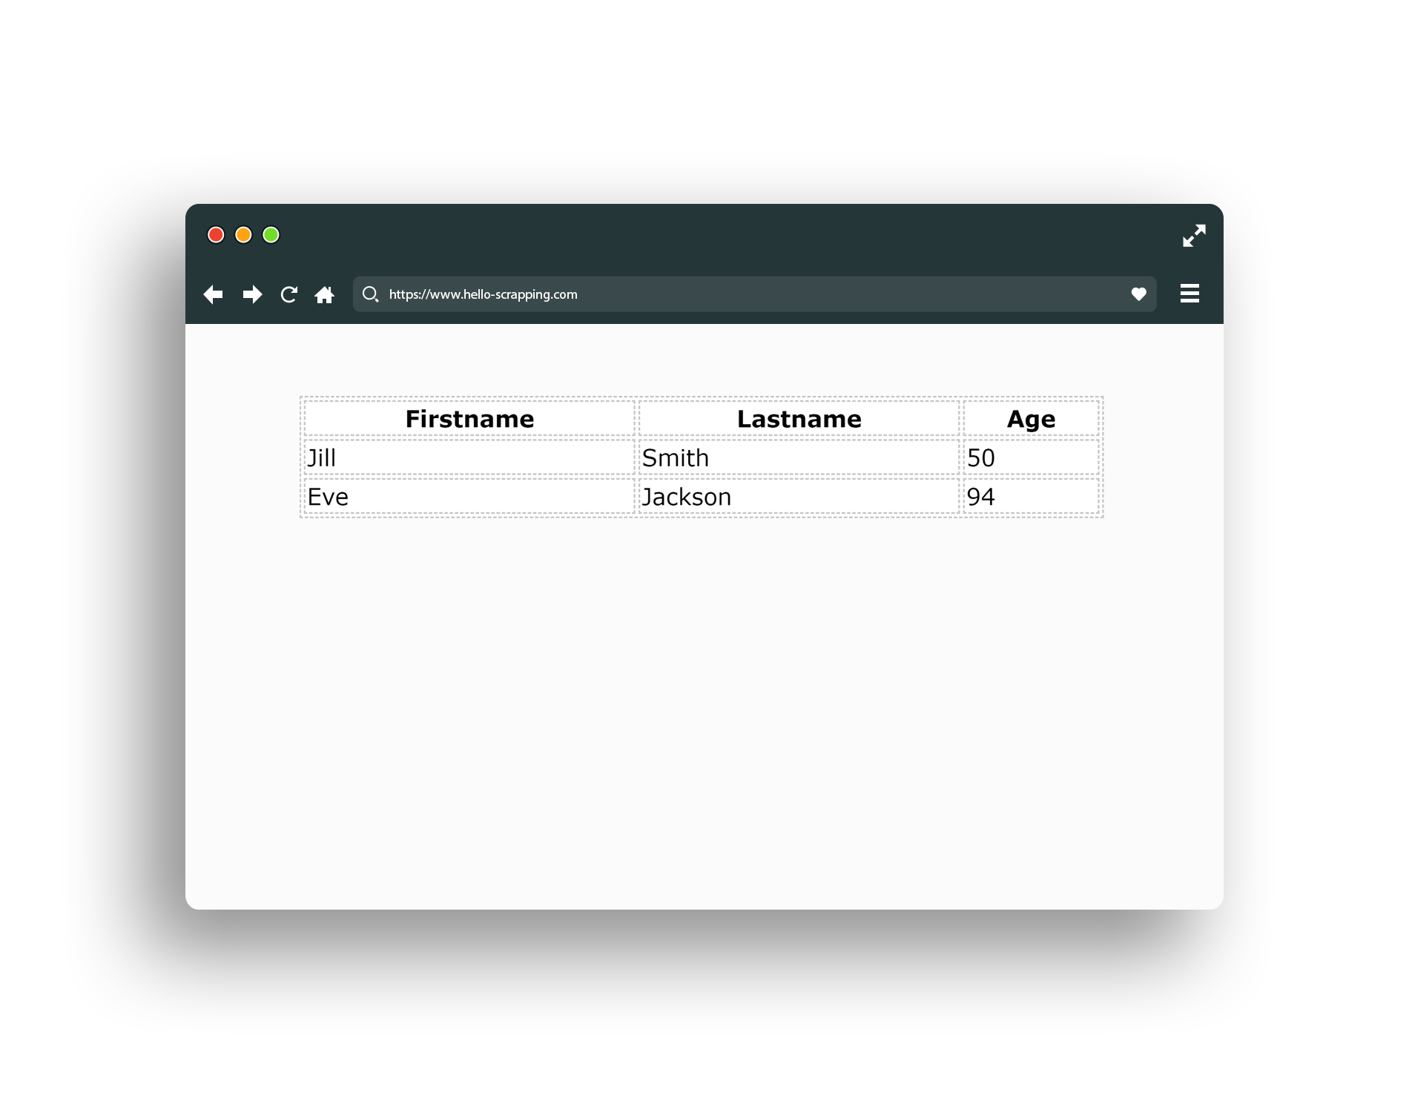
HTML (table)

Slide 26
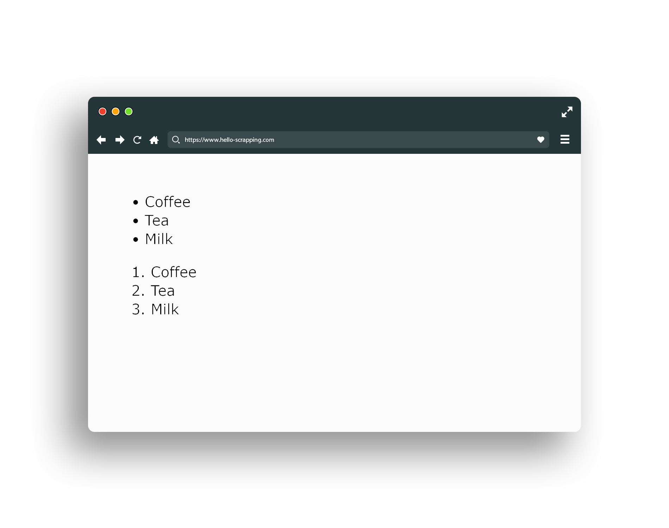
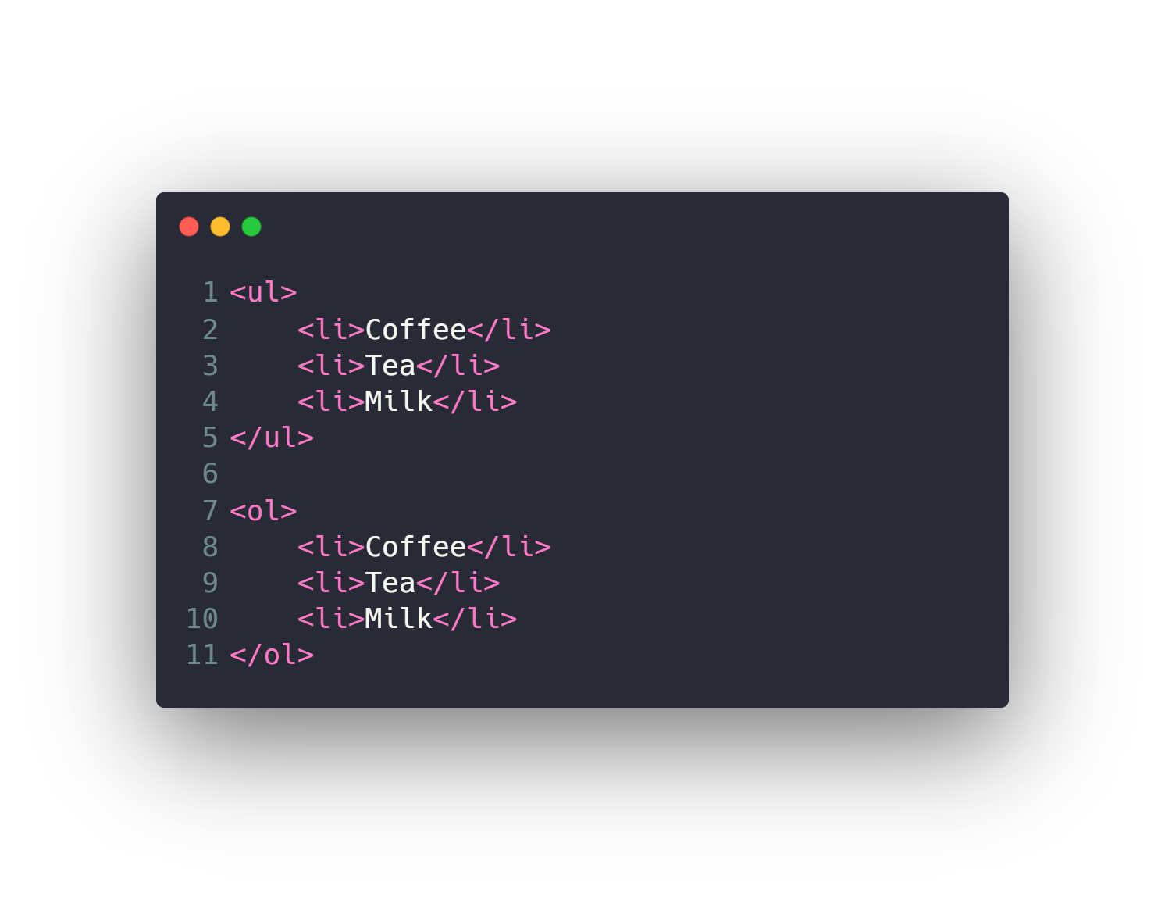
HTML (list)

Slide 27
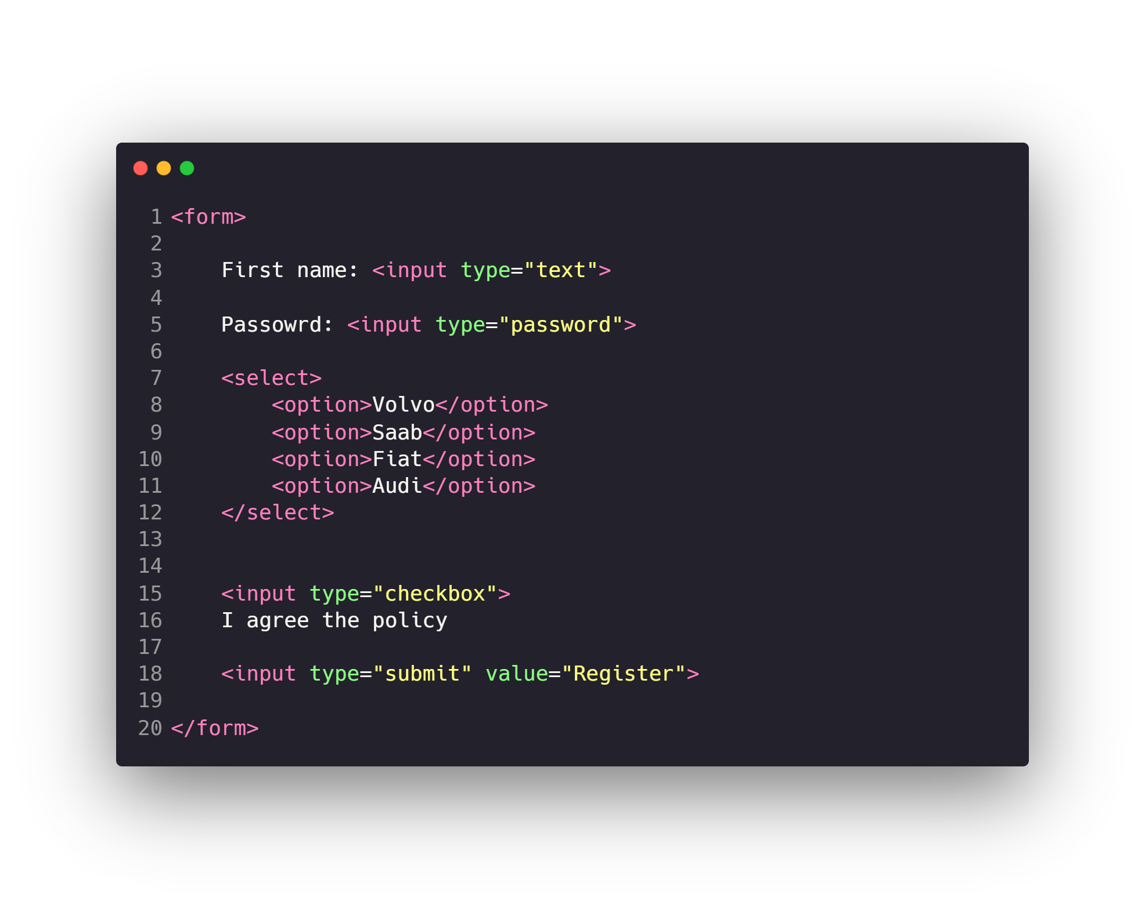
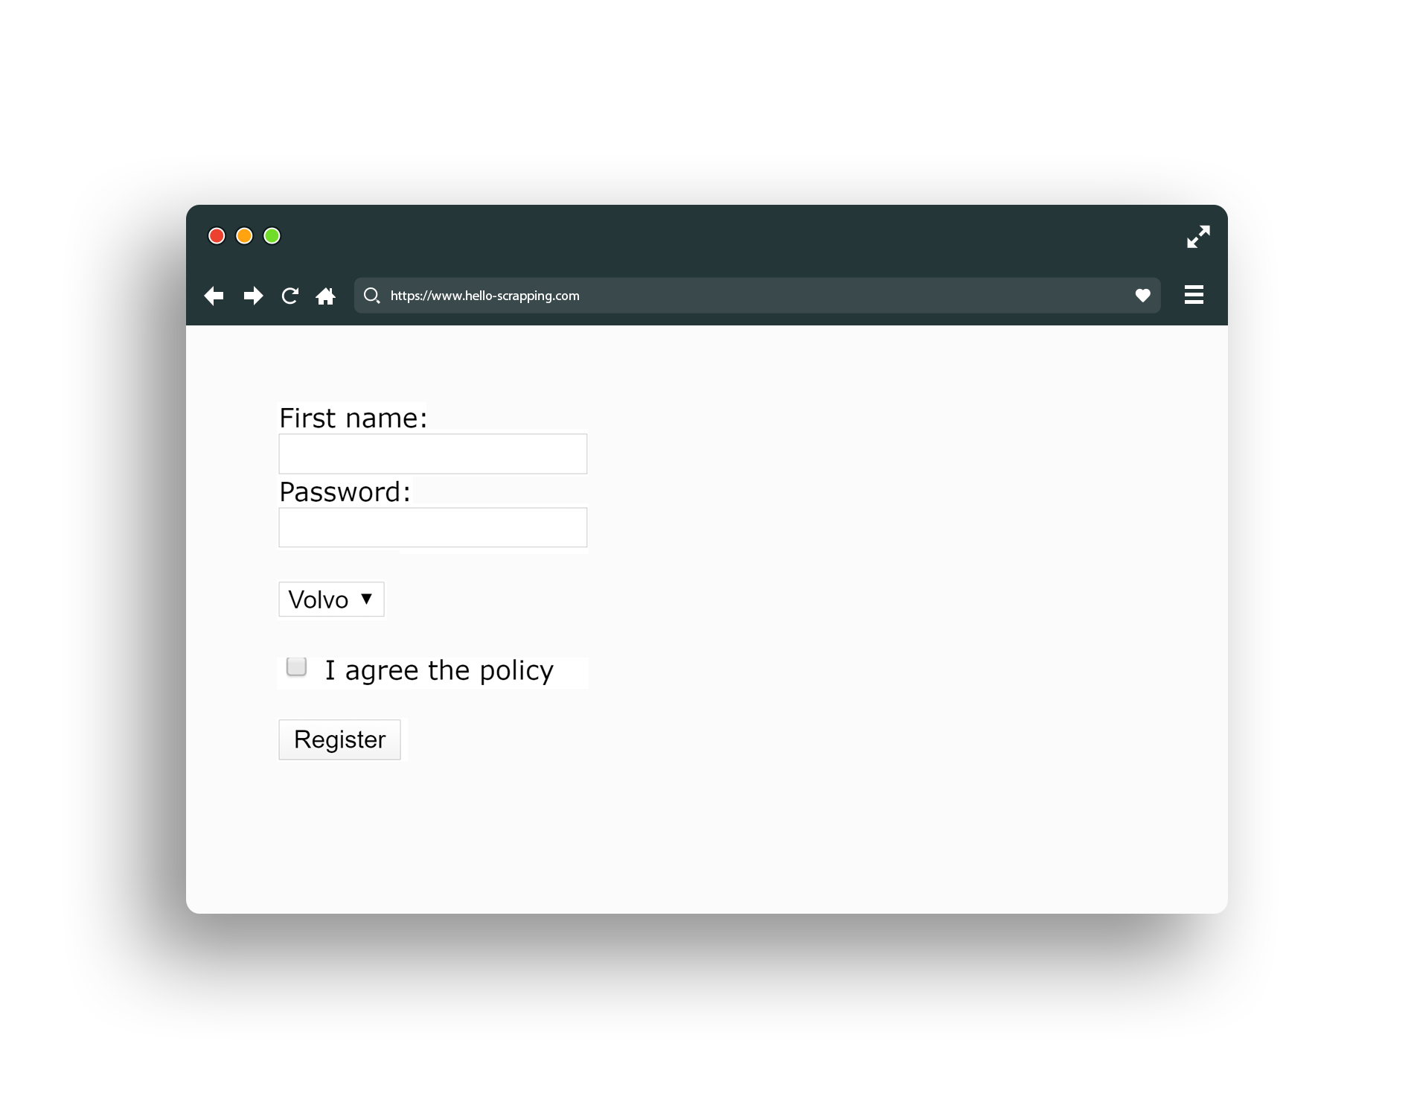
HTML (form)

Slide 28
Other HTML Elements
Div
Span
Video
Audio
Iframe
Header
Footer
Canvas
…

Slide 29
Agenda
What is Network Topologies
What is Internet and Web Servers
HTTP Request/Response Cycle
HTML
CSS
Scrapping Concept
BeautifulSoap Library
REST API Web Services
Work with JSON

Slide 30
CSS
Text & Fonts
Colors
Backgrounds
Borders
Margin & Padding
Width & Height
Gradient
Shadows
…

Slide 31
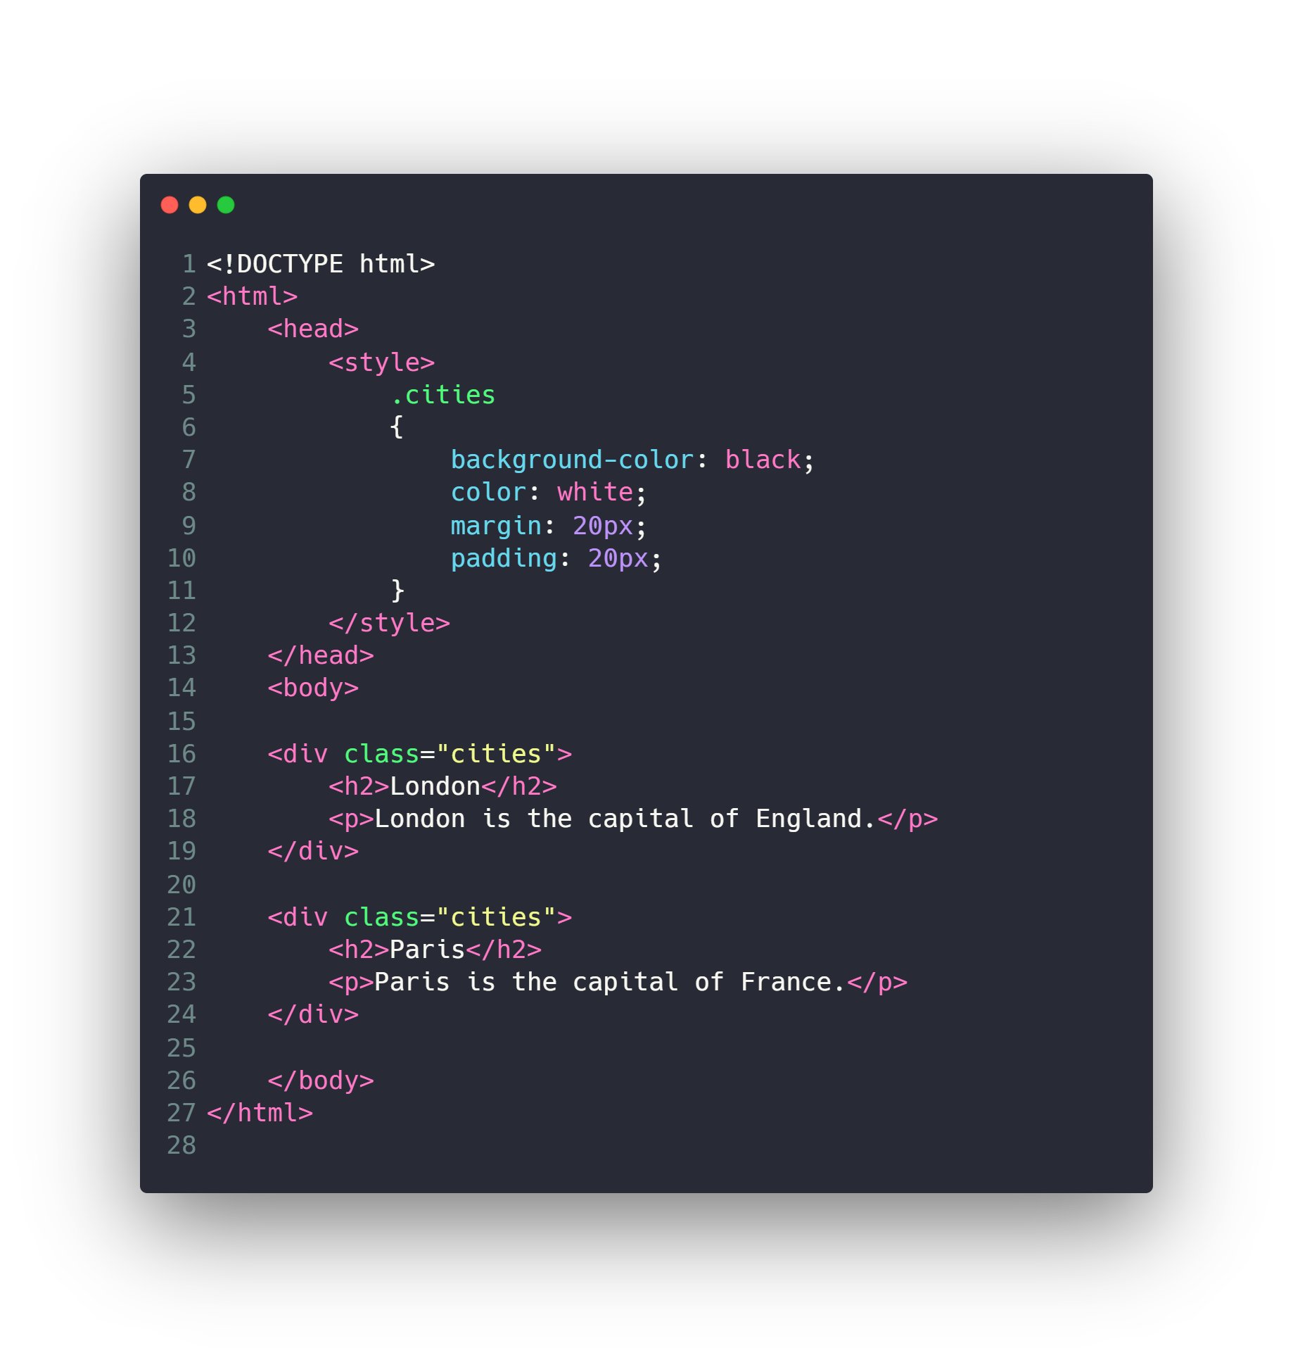
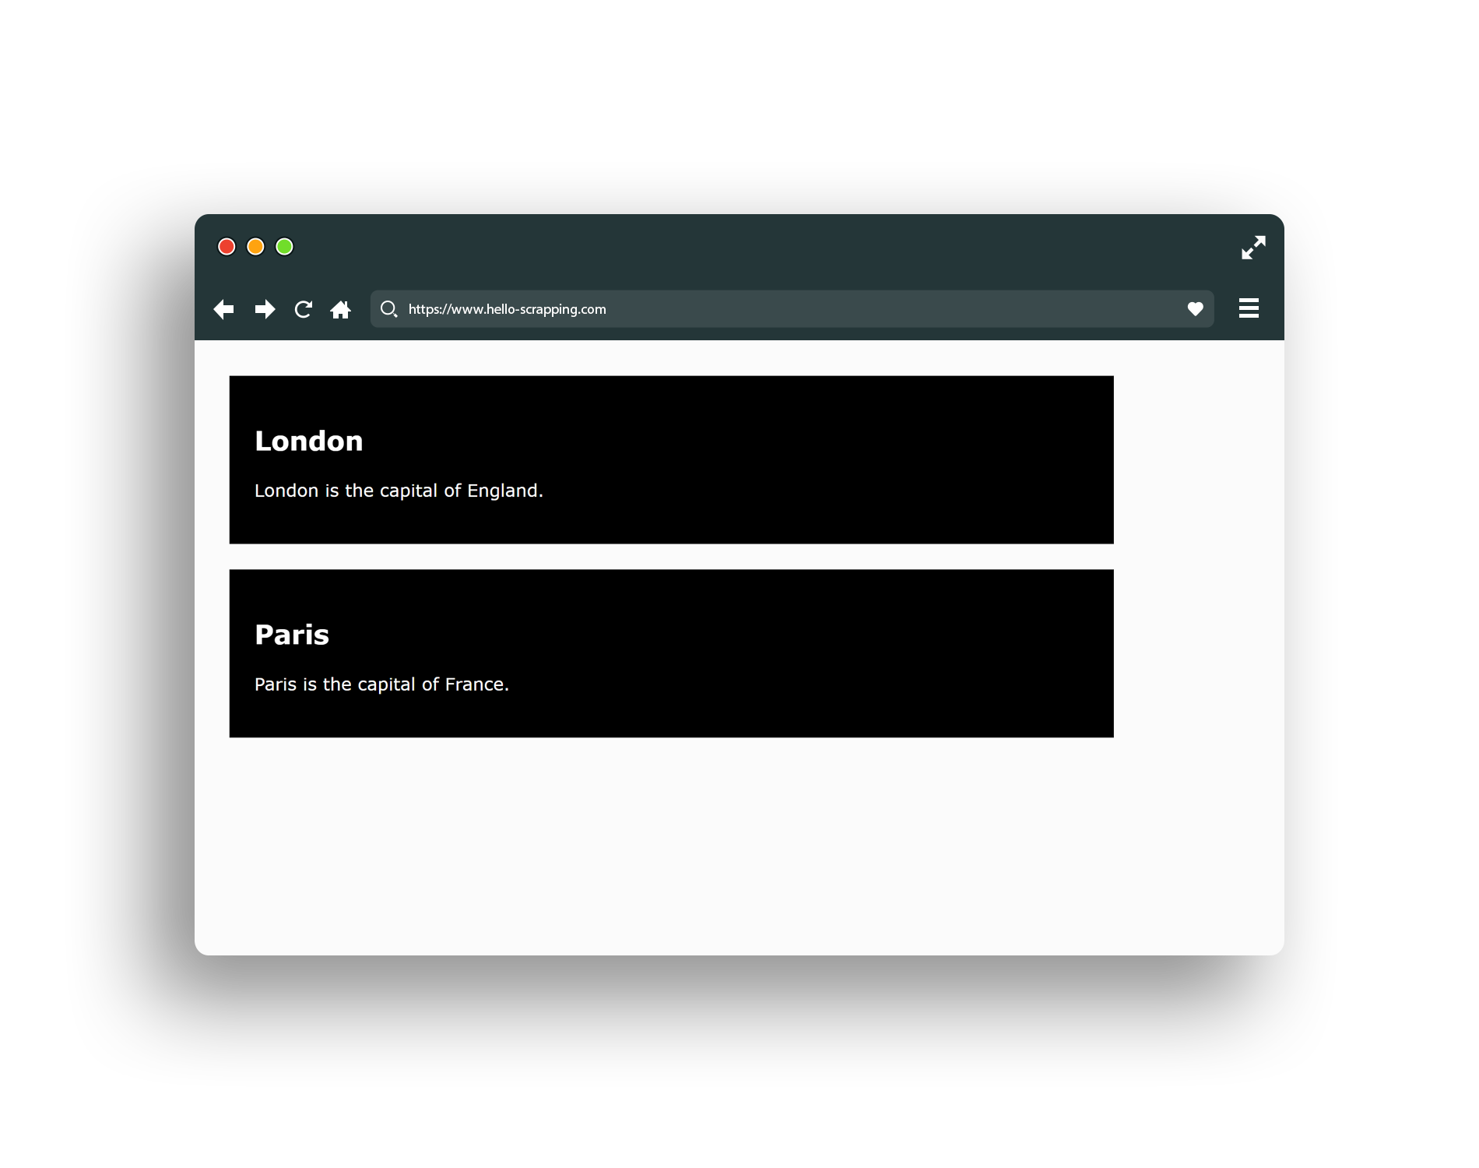
Classes and ID

Slide 32

Check Also
JavaScript
React & Angular
Ajax
Web Sockets
PHP: Laravel
Python: Flask, Django
JavaScript: Node.js
…

Slide 33
Agenda
What is Network Topologies
What is Internet and Web Servers
HTTP Request/Response Cycle
HTML
CSS
Scrapping Concept
BeautifulSoap Library
REST API Web Services
Work with JSON

Slide 34
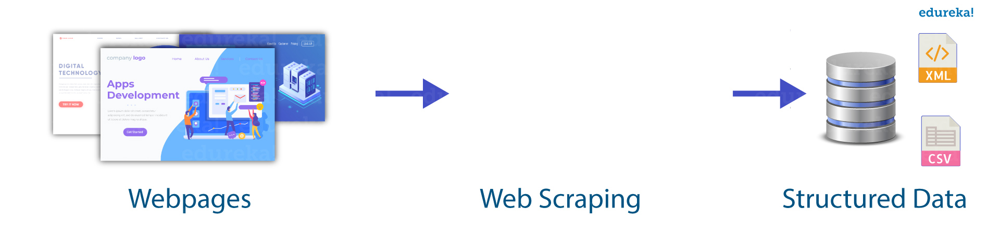
Scrapping Concept

Slide 35
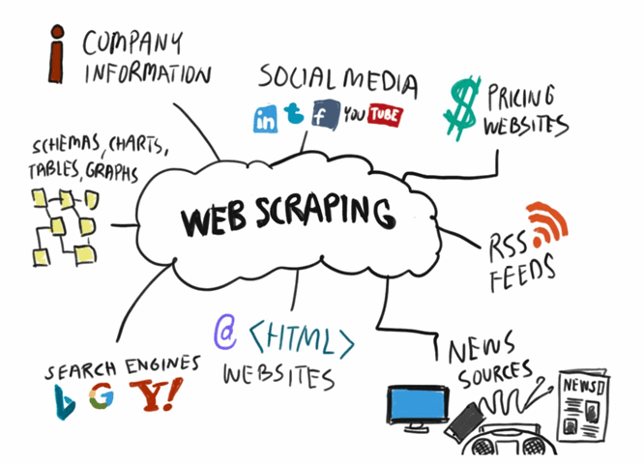
Scrapping Concept

Slide 36
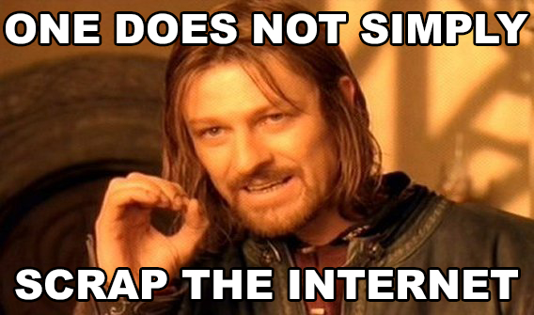
Scrapping Concept

Slide 37
Agenda
What is Network Topologies
What is Internet and Web Servers
HTTP Request/Response Cycle
HTML
CSS
Scrapping Concept
BeautifulSoap Library
REST API Web Services
Work with JSON

Slide 38
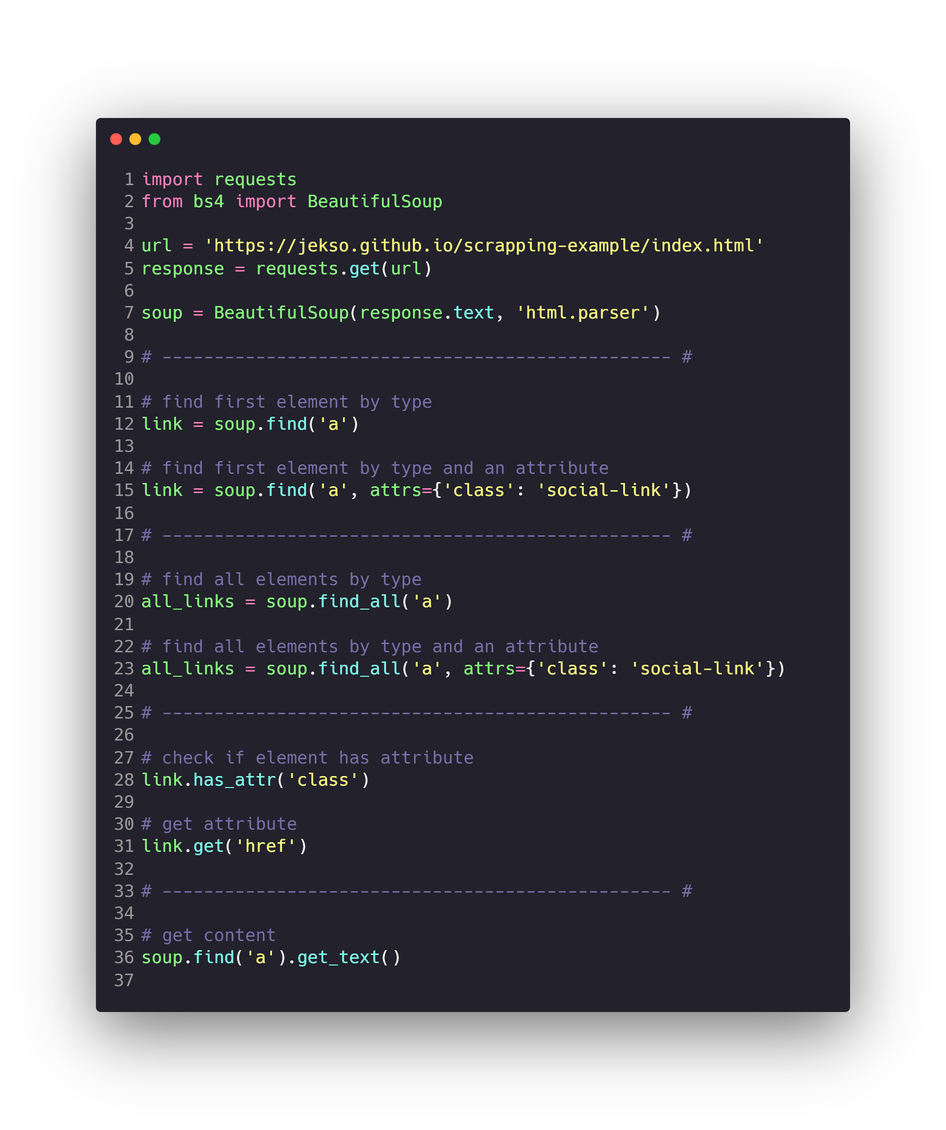

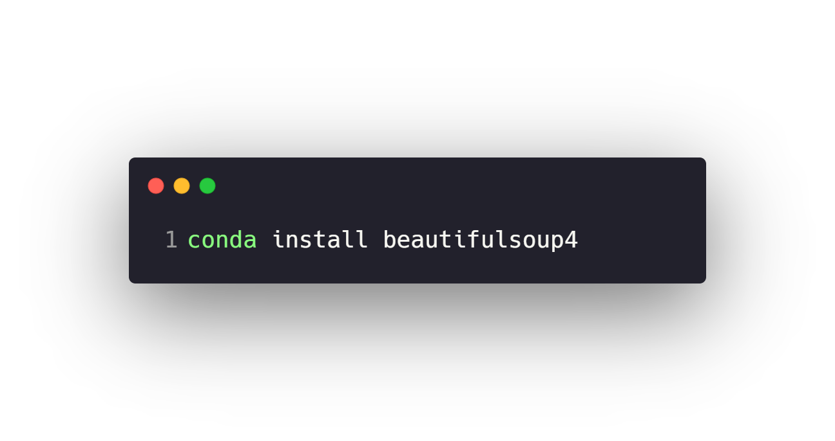
BeautifulSoap Library

Slide 39
Agenda
What is Network Topologies
What is Internet and Web Servers
HTTP Request/Response Cycle
HTML
CSS
Scrapping Concept
BeautifulSoap Library
REST API Web Services
Work with JSON

Slide 40
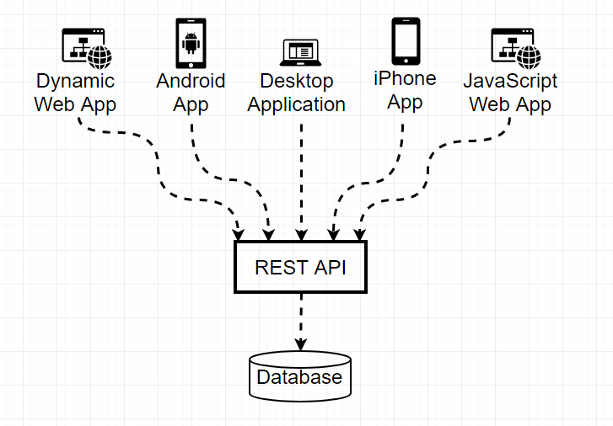
REST API Web Services

Slide 41
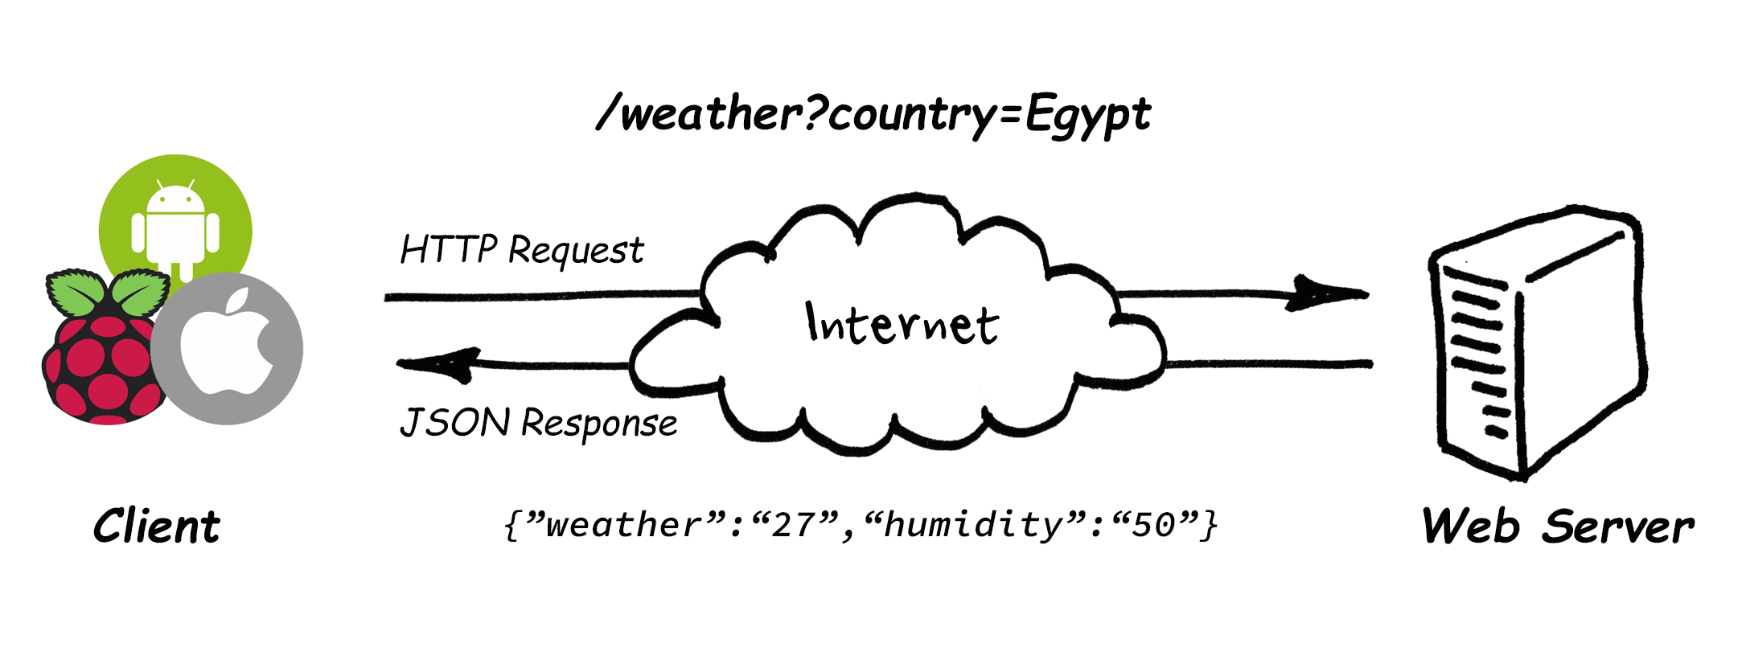
REST API Web Services

Slide 42
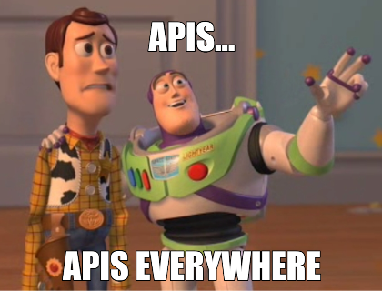
REST API Web Services
https://any-api.com/
https://github.com/public-apis/public-apis
https://cloud.google.com/products/ai
https://www.twilio.com/
…

Slide 43
Agenda
What is Network Topologies
What is Internet and Web Servers
HTTP Request/Response Cycle
HTML
CSS
Scrapping Concept
BeautifulSoap Library
REST API Web Services
Work with JSON

Slide 44
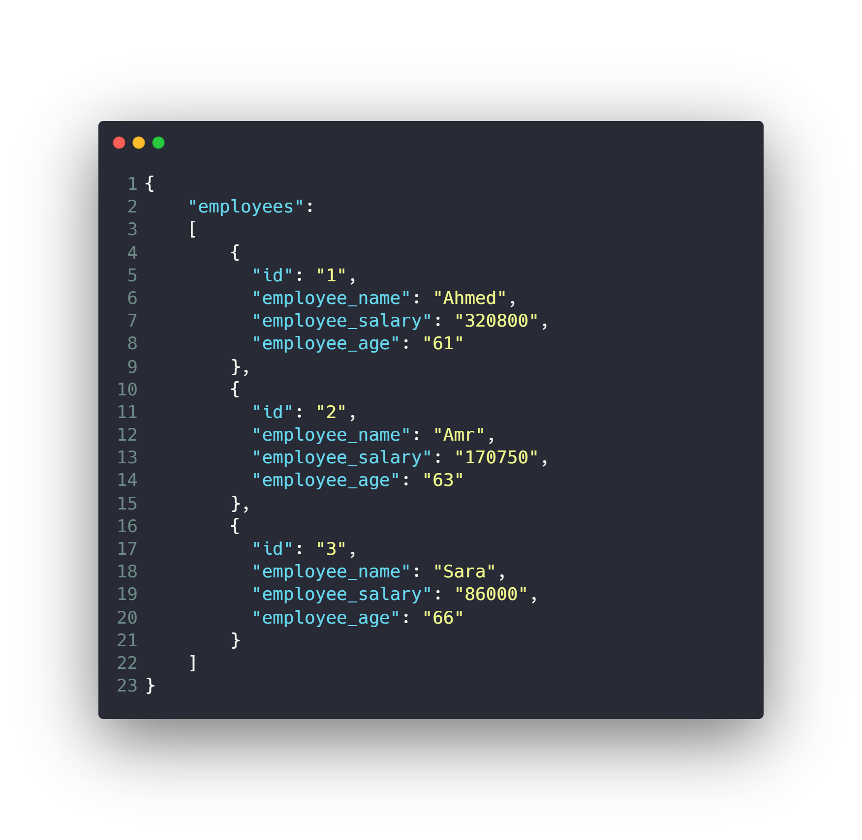
Work with JSON

Slide 45
Work with JSON
Install JSON Viewer extension
For chrome or firefox
https://chrome.google.com/webstore/detail/json-viewer/gbmdgpbipfallnflgajpaliibnhdgobh

Slide 46
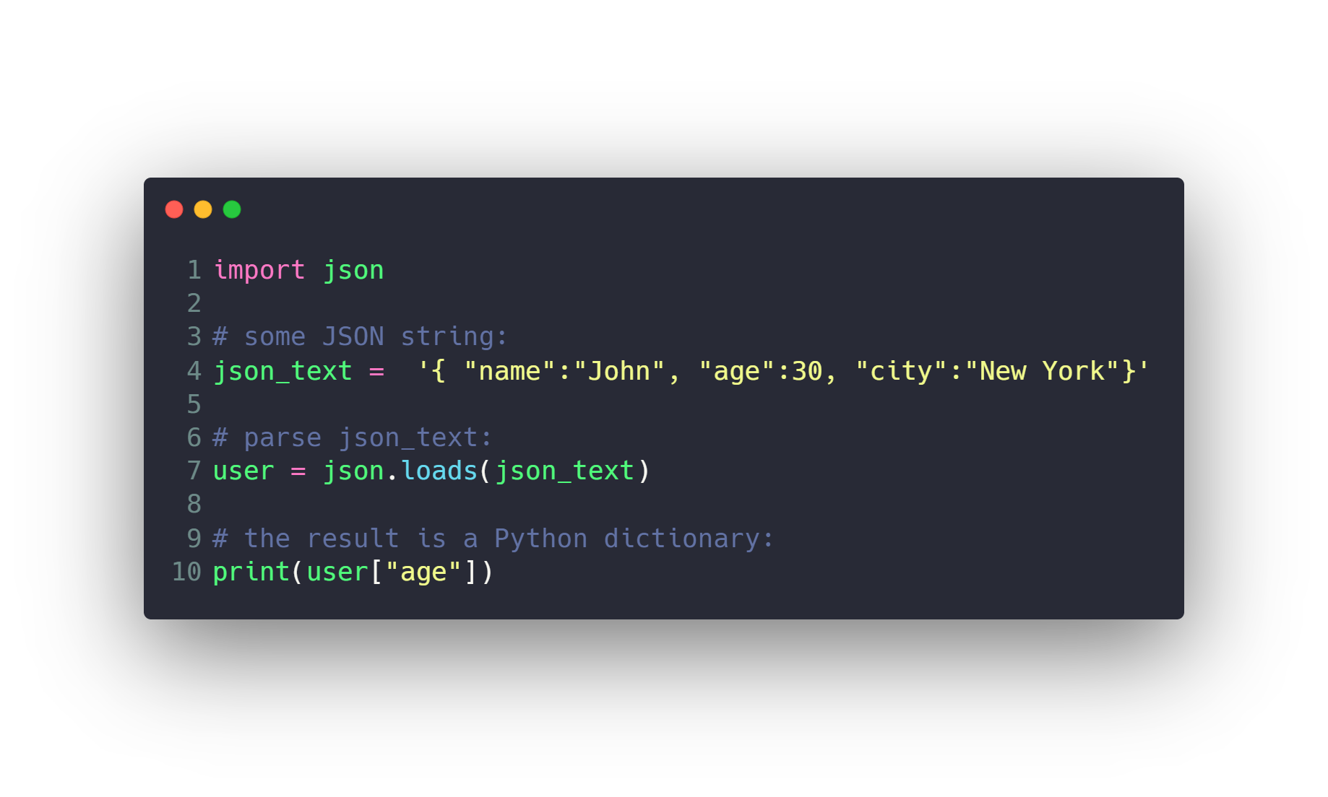
Work with JSON

Slide 47
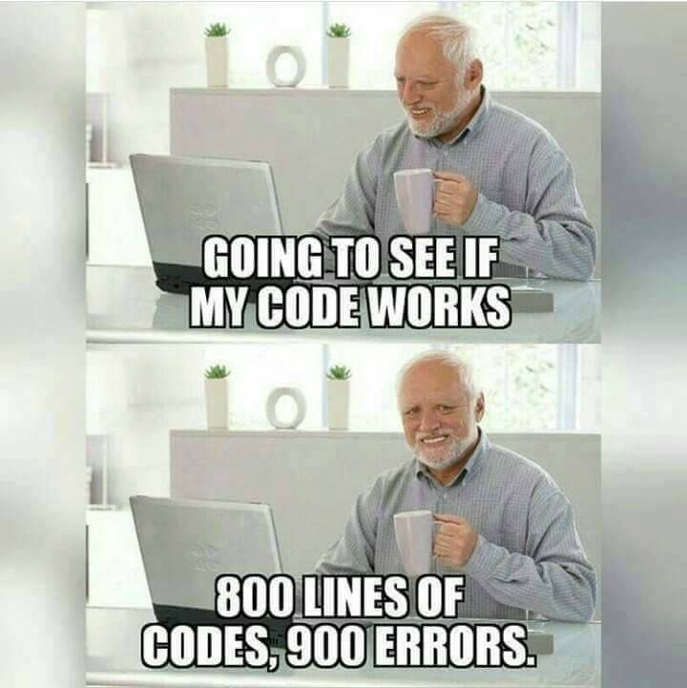

Slide 48
Questions ?!

Slide 49

Thanks! >_ Live long and prosper

